Slide 1
Implementing Dynamic Foot Shape Models to Improve Spacesuit Boot Fit
Abhishektha (Abhi) Boppana | PhD Thesis Defense
Mar 30 2022

Slide 2
Thesis Committee
Allison Anderson, PhD - CU Boulder Aerospace Engineering Sciences
David Klaus, PhD - CU Boulder Aerospace Engineering Sciences
Torin Clark, PhD - CU Boulder Aerospace Engineering Sciences
Rodger Kram, PhD - CU Boulder Integrative Physiology
Daniel Feeney, PhD - BOA Technology
Notes:
Dan: biomechanics research engineer

Slide 3
Motivation
Planetary exploration and spacesuit injury incidence

Slide 4
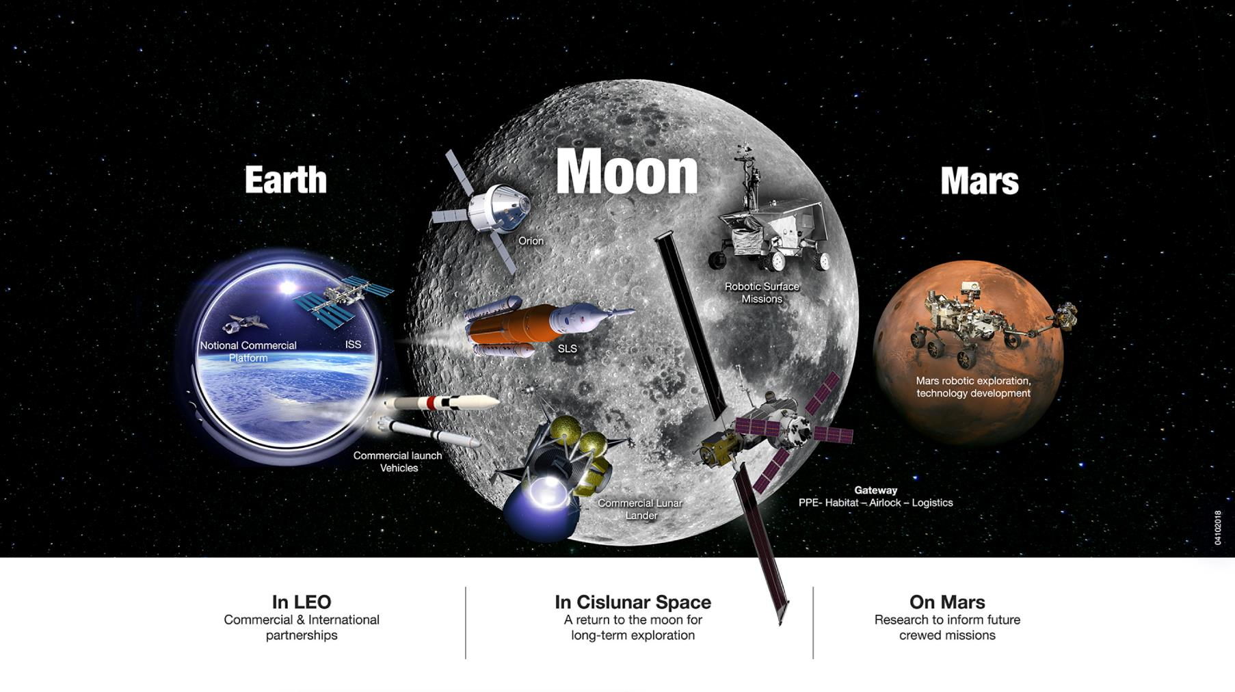
Notes:
The future of crewed space exploration is planetary.

Slide 5
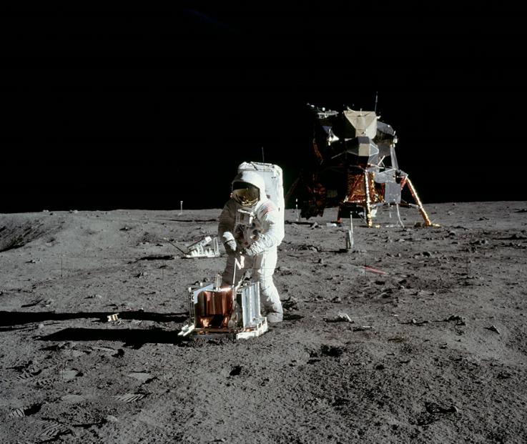
Planetary Exploration
“Success of planetary exploration depends on the ability of humans to work on and explore the surface”¹
EVA: Extravehicular Activity
Experience limited to 78 hours over 6 Apollo missions²
1.8 km longest traverse (Apollo 12)
22 hrs EVA/36 hour stay (Apollo 17)
Buzz Aldrin performing EVA tasks on Apollo 11 (nasa.gov)
¹Drake BG, Watts KD. Human Exploration of Mars Design Reference Architecture 5.0 (2014). NASA/SP-2009-566-ADD2.
²Portree, D. S., and Trevino, R. C., Walking to Olympus: An EVA Chronology, NASA History Office, Washington, DC, 1997.

Slide 6
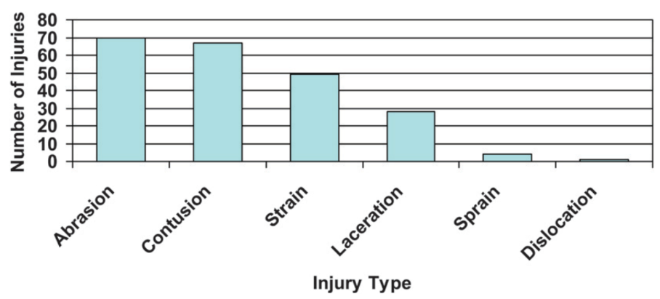
EVA Injury Incidence
EVA spacesuit components are the leading source of in-flight injuries²
Apollo astronauts complained about fatigue from reduced mobility¹
Injuries reported both in-flight and during ground-based training and evaluation sessions
Contact Injuries
Musculoskeletal Injuries
In-flight injuries throughout the U.S. space program. Modified from Scheuring et al. 2009²
¹Scheuring, R. A., Jones, J. A., Novak, J. D., Polk, J. D., Gillis, D. B., Schmid, J., Duncan, J. M., and Davis, J. R., “The Apollo Medical Operations Project: Recommendations to Improve Crew Health and Performance for Future Exploration Missions and Lunar Surface Operations,” Acta Astronautica, Vol. 63, Nos. 7–10, 2008, pp. 980–987.
²Scheuring, R. A., Mathers, C. H., Jones, J. A., and Wear, M. L., “Musculoskeletal Injuries and Minor Trauma in Space: Incidence and Injury Mechanisms in U.S. Astronauts,” Aviation Space and Environmental Medicine, Vol. 80, No. 2, 2009, pp. 117–124.

Slide 7
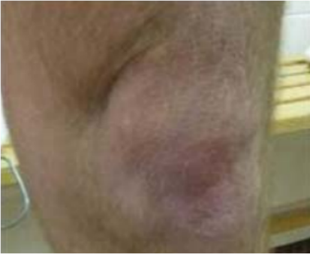
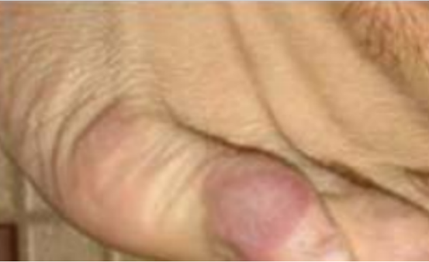
EVA Injury Incidence
EVA spacesuit components are the leading source of in-flight injuries²
Apollo astronauts complained about fatigue from reduced mobility¹
Injuries reported both in-flight and during ground-based training and evaluation sessions
Examples of lower-body spacesuit injury occurring during on-ground training and evaluation
¹Scheuring, R. A., Jones, J. A., Novak, J. D., Polk, J. D., Gillis, D. B., Schmid, J., Duncan, J. M., and Davis, J. R., “The Apollo Medical Operations Project: Recommendations to Improve Crew Health and Performance for Future Exploration Missions and Lunar Surface Operations,” Acta Astronautica, Vol. 63, Nos. 7–10, 2008, pp. 980–987.
²Scheuring, R. A., Mathers, C. H., Jones, J. A., and Wear, M. L., “Musculoskeletal Injuries and Minor Trauma in Space: Incidence and Injury Mechanisms in U.S. Astronauts,” Aviation Space and Environmental Medicine, Vol. 80, No. 2, 2009, pp. 117–124.

Slide 8
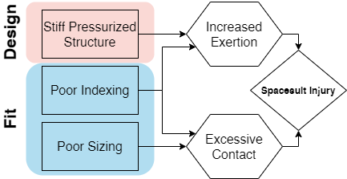
Hypothesized Injury Mechanisms
Stiff, pressurized structure
Need to overcome pressure forces to bend suit joints
Poor indexing:
Misaligned joint centers between operator and spacesuit
Poor sizing
Gaps leading to excessive contact
Limit mobility when undersized

Slide 9
Background
Limits in spacesuit mobility and fit for planetary surface exploration

Slide 10
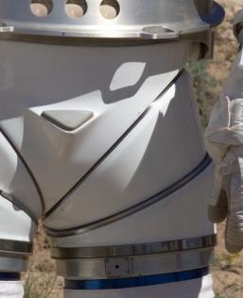
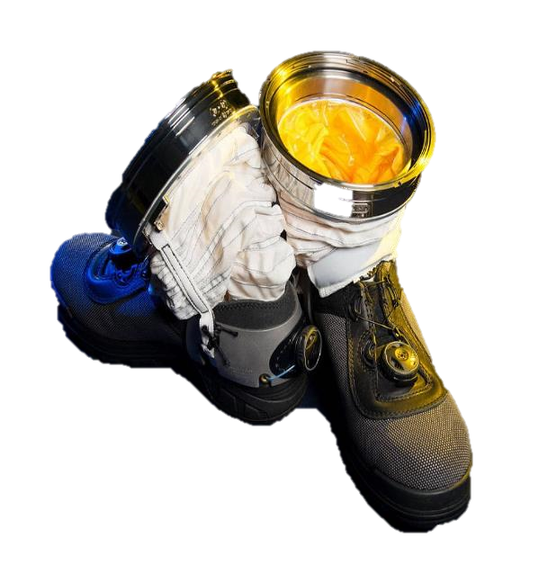
A Stiff, Pressurized Structure
Bending pressurized cylinder reduces volume at joint, hence requiring additional force¹
Constant volume joints reduce force needed
Examples include²:
Convolutes
Bellows
Hard Joints
Left: Hard joint on MK III spacesuit
Right: Convoluted ankle joint on spacesuit boot
¹Newman, D., and Barratt, M., “Life Support and Performance Issues for Extravehicular Activity (EVA),” Fundamentals of Space Life Sciences, edited by S. Churchill, Krieger Publishing Co., Malabar, FL, 1997, pp. 1–61.
²Harris, G. L., The Origins and Technology of the Advanced Extravehicular Space Suit, American Astronautical Society, San Diego, CA, 2001.

Slide 11
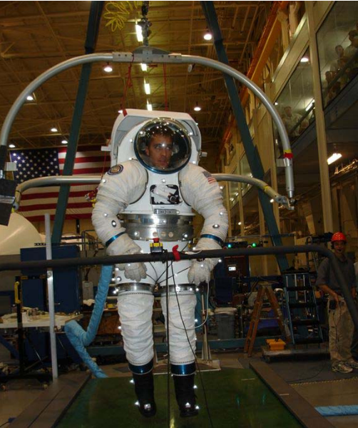
Suited Effects on Ambulation
Suit increases metabolic cost during ambulation¹
Suit pressure and suit weight do not fully explain the increased metabolic cost²
Potential factors: fit, biomechanics of suit, stability
Inhibited mobility while walking compared to unsuited³
Reduced toe and heel clearance
Decreased speed, stride length, step length
Suited ambulation test in the MK III spacesuit²
¹Norcross, J. R., Lee, L. R., Clowers, K. G., Morency, R. M., Desantis, L., DeWitt, J. K., Jones, J. A., Voss, J. R., and Gernhardt, M. L., “Feasibility of Performing a Suited 10-Km Ambulation on the Moon - Final Report of the EVA Walkback Test (EWT),” NASA/TP-2009-214796, NASA Johnson Space Center, Houston, TX, 2009.
²Norcross, J., Clowers, K., Clark, T., Harvill, L., Morency, R. M., Stroud, L. C., Vos, J. R., and Gernhardt, M. L., “Metabolic Costs and Biomechanics of Level Ambulation in a Planetary Suit,” NASA/TP-2010-216115, NASA Johnson Space Center, Houston, TX, 2010.
³Cullinane, C. R., Rhodes, R. A., and Stirling, L. A., “Mobility and Agility during Locomotion in the Mark III Space Suit,” Aerospace Medicine and Human Performance, Vol. 88, No. 6, 2017, pp. 589–596

Slide 12
Spacesuit Fit Limitations
Apollo EVA suits custom tailored¹
Current suits must be fit with variously sized components¹
Sizing rings and tension straps to adjust length
Pads for additional comfort and indexing
Goal: design for 5th percentile female-95th percentile male²
What measurement to use for percentiles?
EMU actual accommodation: 40th female-95th percentile male²
Baseline suit fit derived from operator’s linear anthropometry using proprietary suiting algorithms, then operator feedback used to optimize suit fit²
¹Harris, G. L., The Origins and Technology of the Advanced Extravehicular Space Suit, American Astronautical Society, San Diego, CA, 2001.
²Kim, K. H., Young, K., Benson, E., Jarvis, S., Vu, L., Hernandez, Y., and Rajulu, S., “Human Modeling Tools for Spacesuit and Hardware Design and Assessment,” DHM and Posturography, edited by S. Scataglini and P. Gunther, Academic Press, 2019, pp. 613–625.
Notes:
Based on the hardware produced during the EMUprogram, the actual anthropometric range that could adequatelyfit in the EMU ranged from a 40th percentile female to a95th percentile male. The appropriate suit component sizing for each crewmember was based on the linear and circum-ferential measurements of body shapes, including stature, inter-scye breadth, bi-deltoid breadth, vertical trunk diameter,and other critical dimensions

Slide 13
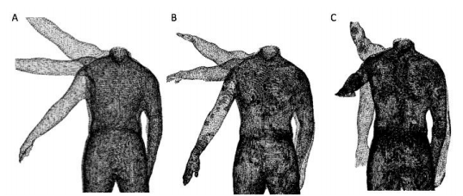
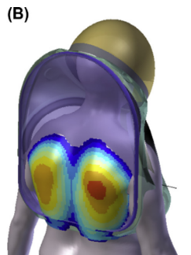
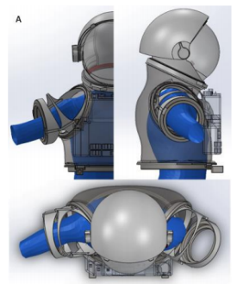
Body-Shape Models for Spacesuits
Linear measurements don’t always represent body shape
Manikins overlaid on 3D suit models to check interference¹
Dynamic models to capture shape changes through motion^{1,2}
Current efforts only capture low-frequency motions
Limited integration into suit design and fit
Dynamic capture of shoulder shape² (top) and testing with hard upper torso (bottom)^{1,2}
¹Kim, K. H., Young, K., Benson, E., Jarvis, S., Vu, L., Hernandez, Y., & Rajulu, S. (2019). Human modeling tools for spacesuit and hardware design and assessment. In S. Scataglini & P. Gunther (Eds.), DHM and Posturography (pp. 613–625). Academic Press.
²Kim, K. H., Young, K. S., Bernal, Y., Boppana, A., Vu, L. Q., Benson, E. A., Jarvis, S., & Rajulu, S. L. (2016). A Parametric Model of Shoulder Articulation for Virtual Assessment of Space Suit Fit. Proceedings of the 7th International Conference on 3D Body Scanning Technologies, 201–207.

Slide 14
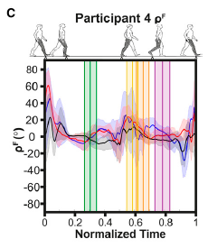
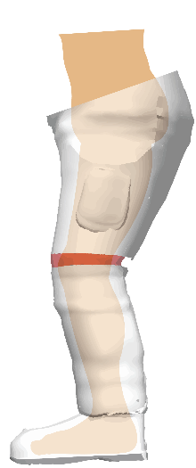
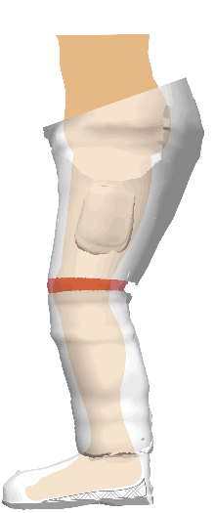
Effect of Fit on Performance
Can an increase in lower body padding be reflected in objective fit metrics?¹
Results very subject-specific, no clear trend
Fit metrics dynamic over gait cycle
Lower body fit may need to be focused on foot-boot interface¹
Subjects reported heel-lift, where heel pops out of boot during heel-off
Dynamic differences femur angular velocity between the operator and spacesuit during gait¹
Heel-lift during gait, where the foot lifts inside the boot (right) at heel-off, resulting in a gap (shaded)
¹Fineman, R. A., McGrath, T. M., Kelty-Stephen, D. G., Andrew, A. F., & Stirling, L. A. (2018). Objective metrics quantifying fit and performance in spacesuit assemblies. Aerospace Medicine and Human Performance, 89(11), 985–995. https://doi.org/10.3357/AMHP.5123.2018

Slide 15
Gaps
Few efforts to quantify fit discrepancies
Limited knowledge on dynamic body-shape changes due to motion
No existing framework for incorporating dynamic body-shape models into the spacesuit design and fit process
No studies to quantify the effect of using dynamic body-shape models over linear measurements on spacesuit fit and mobility

Slide 16
Research Overview

Slide 17
Scope
Limit to spacesuit boot as a test case
Current boots exhibit heel-lift, a symptom of poor fit
Ambulation will be a key component of future planetary surface exploration missions
Focus on gas pressurized spacesuit designs
Mechanical counterpressure is an alternative that has not yet been implemented in operational EVA suit design

Slide 18
Hypothesis
Integrating dynamic body shape changes into the spacesuit boot design process will
1)mitigate factors that lead to injury
2)improve compatibility between the operator and the spacesuit.

Slide 19
Research Aims
Specific Aim 1: Quantify instances of heel-lift in spacesuit gait
Specific Aim 2: Predictively model dynamic changes in foot morphology during gait
Specific Aim 3: Define and validate a design process integrating dynamic foot morphology data for a novel spacesuit boot
Specific Aim 4: Evaluate the prototype planetary spacesuit boot design for fit, comfort, and mobility

Slide 20
Specific Aim 1
Quantify instances of heel-lift in spacesuit gait

Slide 21


Background
Heel-Lift: Delay in heel-off time between spacesuit and operator
Indicator of poor fit
Improper ankle indexing
Excessive contact on foot dorsum
Ankle joint overuse while ambulating
No quantitative method to detect heel-lift
IMUs subject to integration drift and additional error in spacesuit environment¹⁻³
IMU drift correction techniques not evaluated in spacesuit environment
Objective: Evaluate ability of IMUs and drift-correction techniques to quantify the frequency and magnitude of heel-lift in spacesuit
Heel-lift during gait, where the foot lifts inside the boot (right) at heel-off, resulting in a gap (shaded)
¹Bertrand, P. J., Anderson, A., Hilbert, A., & Newman, D. (2014). Feasibility of Spacesuit Kinematics and Human-Suit Interactions. 44th International Conference on Environmental Systems.
²Shen, Y. Y., & Anderson, A. P. (2019). Extended Kalman Filter for Magnetometer-Free Estimation of Spacesuit Wearer Joint Kinematics Using Inertial Measurements. FUSION 2019 - 22nd International Conference on Information Fusion
³Shen, Y.-Y., Wood, S., & Anderson, A. P. (2020, January 6). Evaluation of Wearable Inertial Sensors for Spacesuit Design Applications Using Hardware-in-the-Loop Simulation. AIAA Scitech 2020 Forum.
Notes:
Make sure to refer to the leg as shank here to set-up for terminology in this section

Slide 22
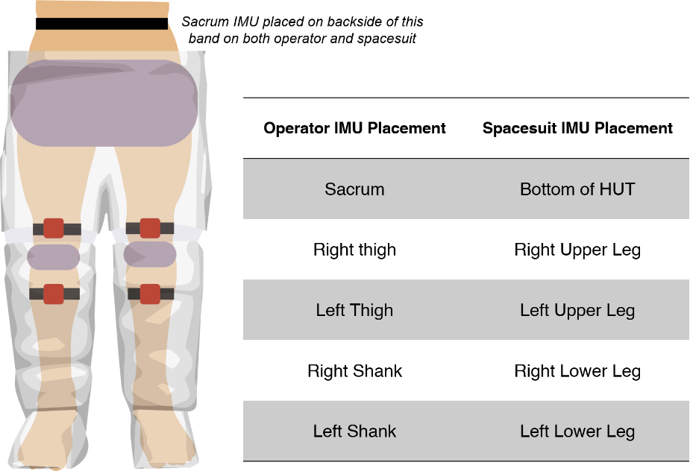
Experimental Data
Collected by Fineman et al. 2018¹
N=3, all male
24 suited trials per config.
No, Low, High Padding
All fit into Large size lower body
Subjects walked in MK III spacesuit
IMUs collected acceleration and orientation information on both operator’s and spacesuit’s pelvis, thigh, shank
Placement of IMUs (red) and padding (gray) in suit assembly.
¹Fineman, R. A., McGrath, T. M., Kelty-Stephen, D. G., Andrew, A. F., & Stirling, L. A. (2018). Objective metrics quantifying fit and performance in spacesuit assemblies. Aerospace Medicine and Human Performance, 89(11), 985–995.
Notes:
Specifically mention Shank and SLL

Slide 23
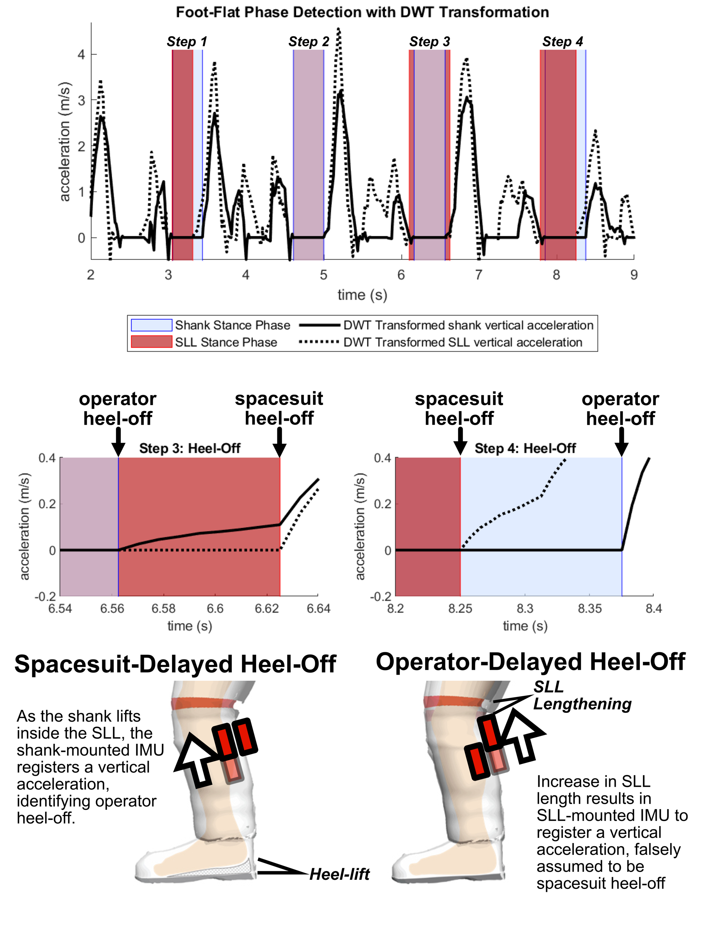
Heel-Off Detection
Discrete Wavelet Thresholding of shank vertical acceleration signal¹
Stance phase detected as period of zero vertical acceleration per each step
Heel-off detected as end of stance phase
Operator heel-off prior to suit heel-off may indicate heel-lift
¹Ji, N., Zhou, H., Guo, K., Samuel, O. W., Huang, Z., Xu, L., & Li, G. (2019). Appropriate mother wavelets for continuous gait event detection based on time-frequency analysis for hemiplegic and healthy individuals. Sensors (Switzerland), 19(16), 1–18.
Notes:
Annotate heel-off points on shaded regions
Maybe split spacesuit and human graphs, animate them together

Slide 24
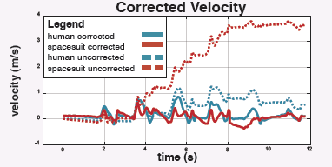
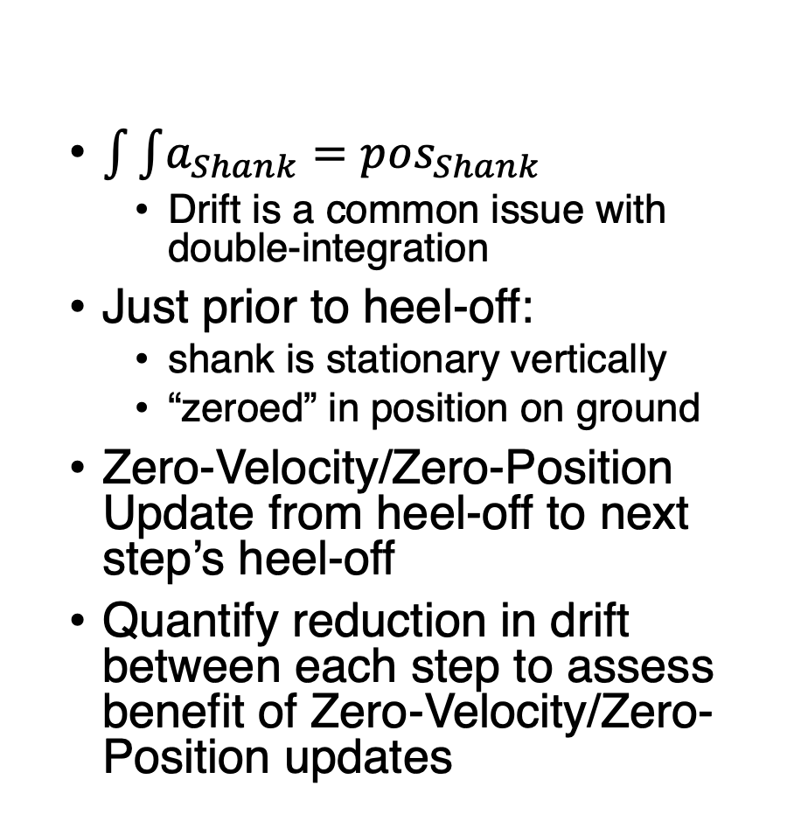
Heel-Lift Measurement
$\int{\int{a_{Shank}}}=pos_{Shank}$
Drift is a common issue with double-integration
Just prior to heel-off:
shank is stationary vertically
“zeroed” in position on ground
Zero-Velocity/Zero-Position Update from heel-off to next step’s heel-off
Quantify reduction in drift between each step to assess benefit of Zero-Velocity/Zero-Position updates
Drift correction from zero-velocity updates
¹Feliz, R., Zalama, E., & García-Bermejo, J. G. (2009). Pedestrian tracking using inertial sensors. Journal of Physical Agents, 3(1), 35–42.

Slide 25
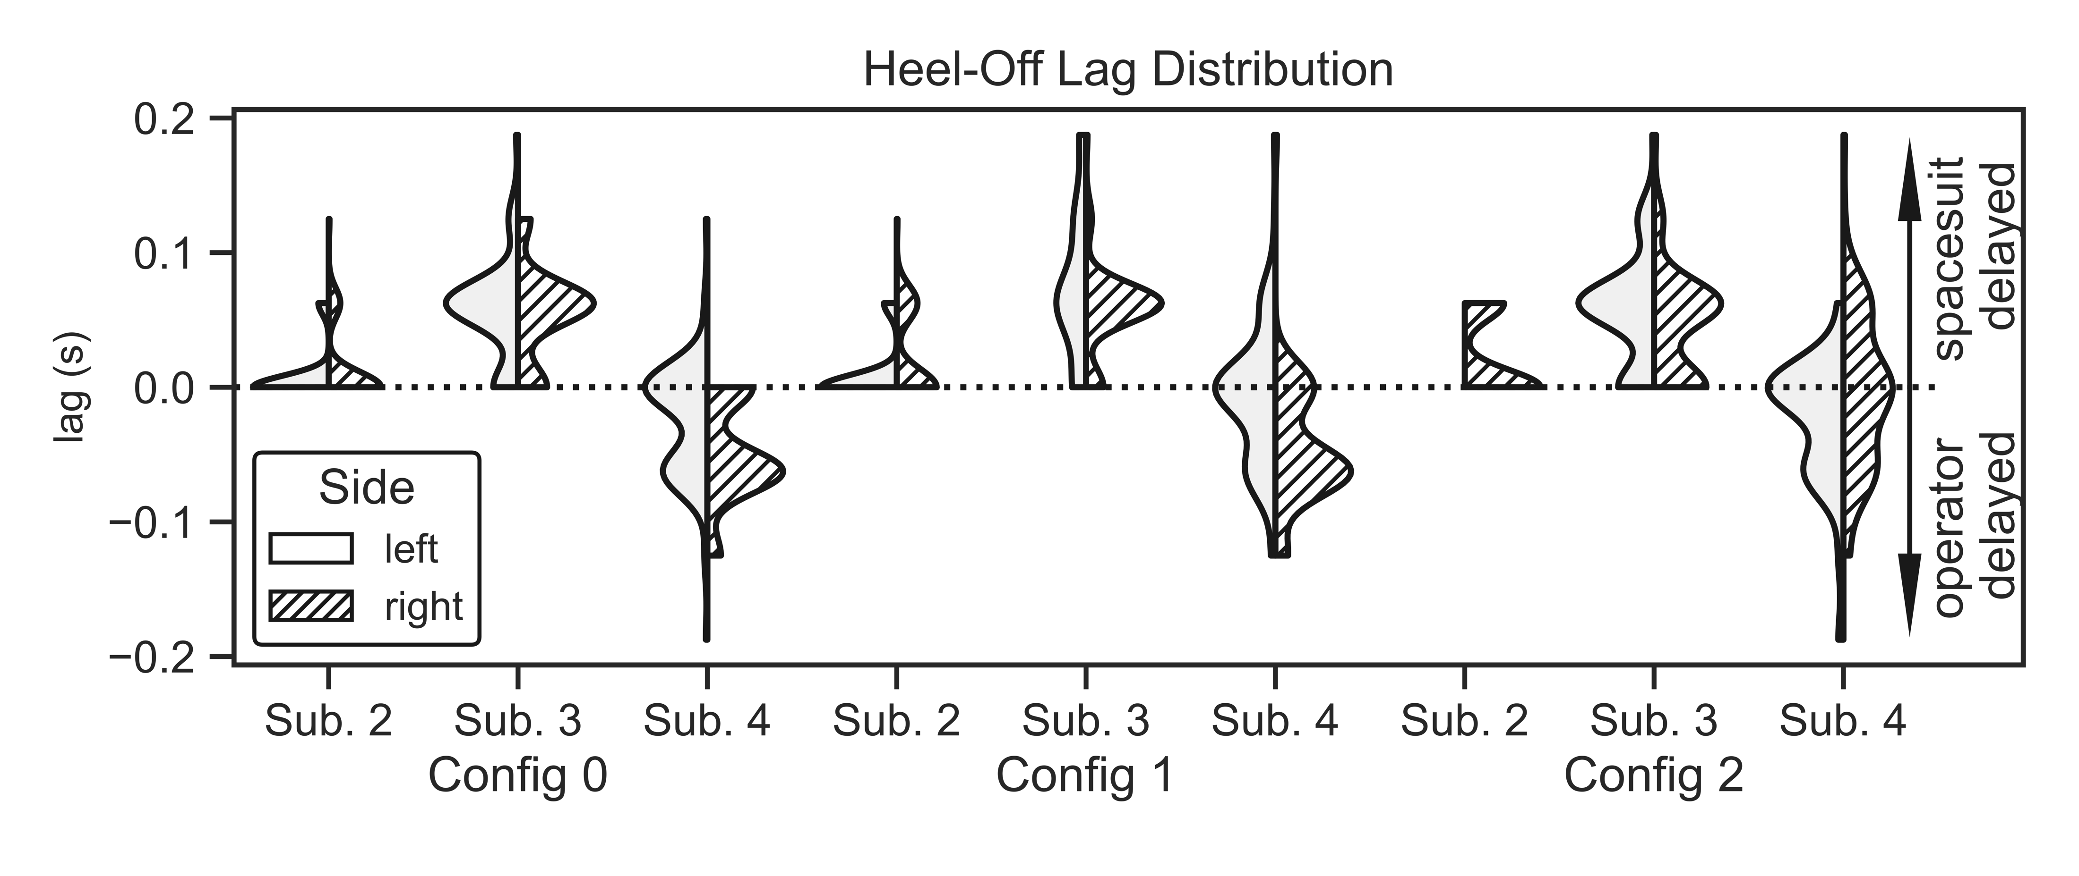
Results
Drift was not reduced enough to make a quantifiable measurement
At 0.04s, drift may already exceed 1cm in spacesuit-mounted IMU
Lag in heel-off time quantified across subjects and conditions
Positive lag may indicate heel-lift
Negative lag may be due to spacesuit’s pressure forces extending lower leg
Distribution of heel-off lags across subjects and configurations
Notes:
Talk through plot – mention the
Maybe animate the pressure-forces effect
Overlay configurations diagram over the 1,2,3 groups
Show that configuration did not mitigate the issues

Slide 26
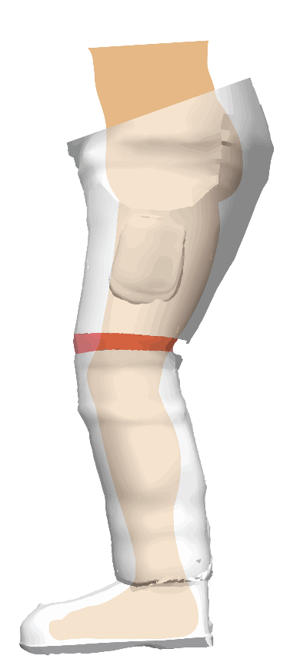
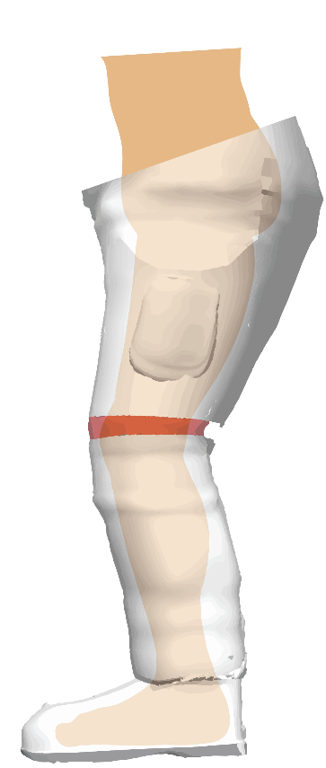
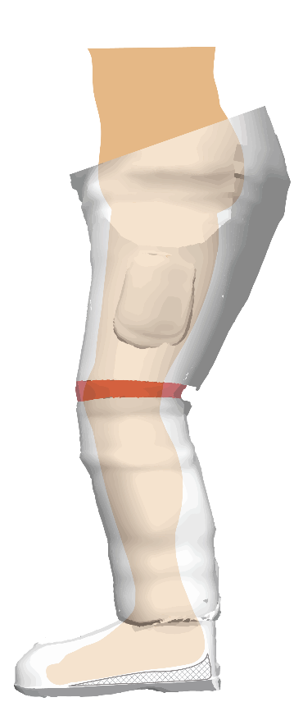
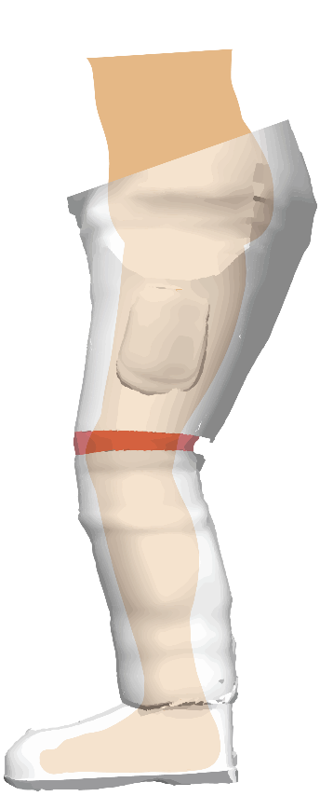
Results
Drift was not reduced enough to make a quantifiable measurement
At 0.04s, drift may already exceed 1cm in spacesuit-mounted IMU
Lag in heel-off time quantified across subjects and conditions
Positive lag may indicate heel-lift
Negative lag may be due to spacesuit’s pressure forces extending lower leg
Vertical acceleration of SLL IMU prior to shank IMU
Vertical acceleration of shank IMU prior to SLL IMU
Spacesuit mechanics that result in negative (left) and positive (right) heel-off lag
Notes:
Talk through plot – mention the
Maybe animate the pressure-forces effect
Overlay configurations diagram over the 1,2,3 groups
Show that configuration did not mitigate the issues

Slide 27
Summary
Conclusions:
IMUs mounted on spacesuit may be subject to noise from pressure forces
Zero Velocity Updates do not reduce drift enough to quantify heel-lift
Future work to evaluate contact sensors for direct detection of heel-lift instances
Notes:
Clarify ZVUs for spacesuit mounted IMUs

Slide 28
Specific Aim 2
Predictively model dynamic changes in foot morphology during gait

Slide 29
Background
Novel spacesuit boot design requires understanding of foot shape
Foot shape is highly variable in population by sex¹⁻³, age⁴, weight⁵, and while loaded during stance phase^{6,7}
Existing technology to capture dynamic foot shape is expensive and not developed around a treadmill⁷
No statistical shape models developed to predict foot shape across population and during motion
¹Wunderlich, R. E., & Cavanagh, P. R. (2001). Gender differences in adult foot shape: Implications for shoe design. Medicine and Science in Sports and Exercise, 33(4), 605–611.
²Krauss, I., Grau, S., Mauch, M., Maiwald, C., & Horstmann, T. (2008). Sex-related differences in foot shape. Ergonomics, 51(11), 1693–1709.
³Krauss, I., Valiant, G., Horstmann, T., & Grau, S. (2010). Comparison of female foot morphology and last design in athletic footwear-are men’s lasts appropriate for women? Research in Sports Medicine, 18(2), 140–156.
⁴Tomassoni, D., Traini, E., & Amenta, F. (2014). Gender and age related differences in foot morphology. Maturitas, 79(4), 421–427.
⁵Price, C., & Nester, C. (2016). Foot dimensions and morphology in healthy weight, overweight and obese males. Clinical Biomechanics, 37, 125–130.
⁶Kouchi, M., Kimura, M., & Mochimaru, M. (2009). Deformation of foot cross-section shapes during walking. Gait and Posture, 30(4), 482–486.
⁷Barisch-Fritz, B., Schmeltzpfenning, T., Plank, C., & Grau, S. (2014). Foot deformation during walking: Differences between static and dynamic 3D foot morphology in developing feet. Ergonomics, 57(6), 921–933.
Notes:
Lead off with this explicitly (add bullet point): Mention how designing a better fitting boot requires a thorough understanding of foot shape. Achieve good resolution limited by current efforts, need to motivate the gap in spacesuit boot design (link to terrestrial boot definciens like here)

Slide 30
Objectives
Develop a low-cost 4D scanning system capable of capturing foot shape around a treadmill
Create a predictive model of foot shape changes across the dorsal surface during stance phase
Identify specific areas of the foot that change shape during stance phase
Correlate changes in foot shape across large-scale population foot measurements

Slide 31
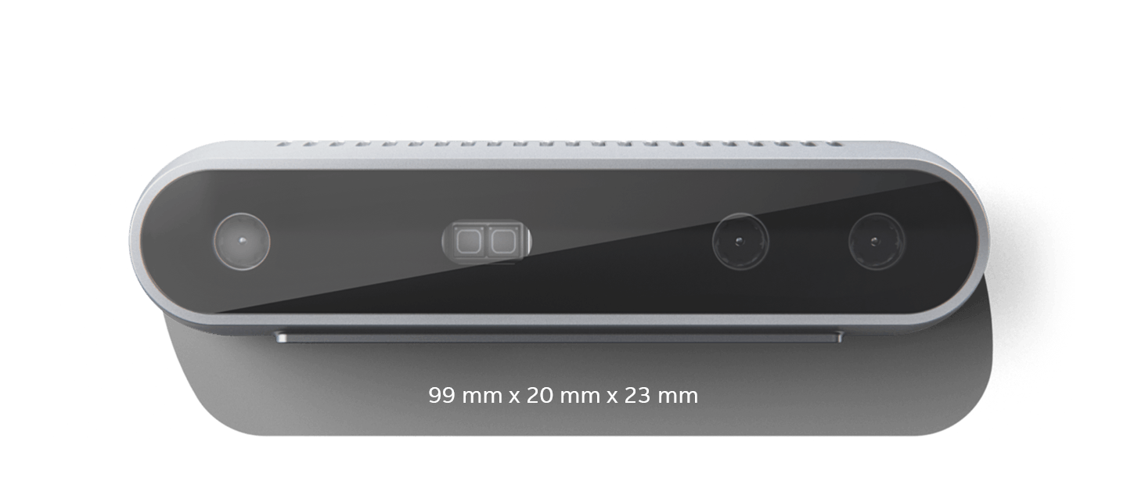
Custom 4D Scanning System
Intel RealSense D415:
Outputs 3D point clouds at up to 90 frames-per-second
$150
15cm to 10m range
Accuracy: ~2% of range
DynaMo¹: software library to use multiple Intel RealSense cameras for dynamic body shape capture
¹Boppana and Anderson. DynaMo: Dynamic Body Shape and Motion Capture with Intel RealSense Cameras (2019). Journal of Open Source Software.

Slide 32
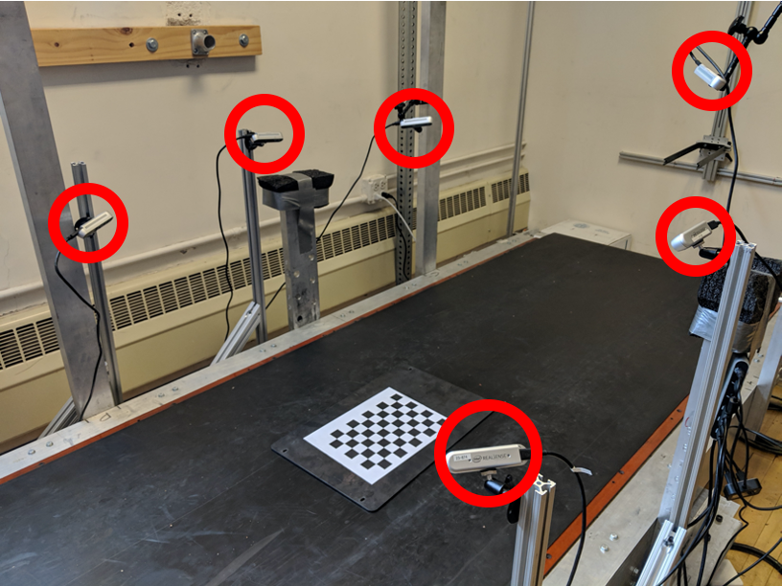
Data Collection Procedures
30 Subjects (15m/15f)
Stratified sampling by height for diversity in foot length
Subject anthropometry
Height, weight, foot length, foot width, arch length
Foot Preparation
Left foot covered in black sock
Right foot marked with 18 reflective markers
Subject walks on treadmill at 1.4 m/s
1 minute warm-up
Data collection for 10 seconds
Review and repeat if necessary
Data collection treadmill in CU Locomotion Laboratory
Notes:
Link to the github

Slide 33
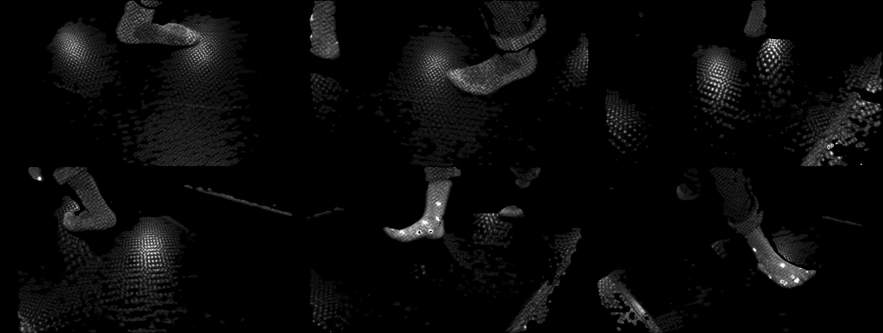
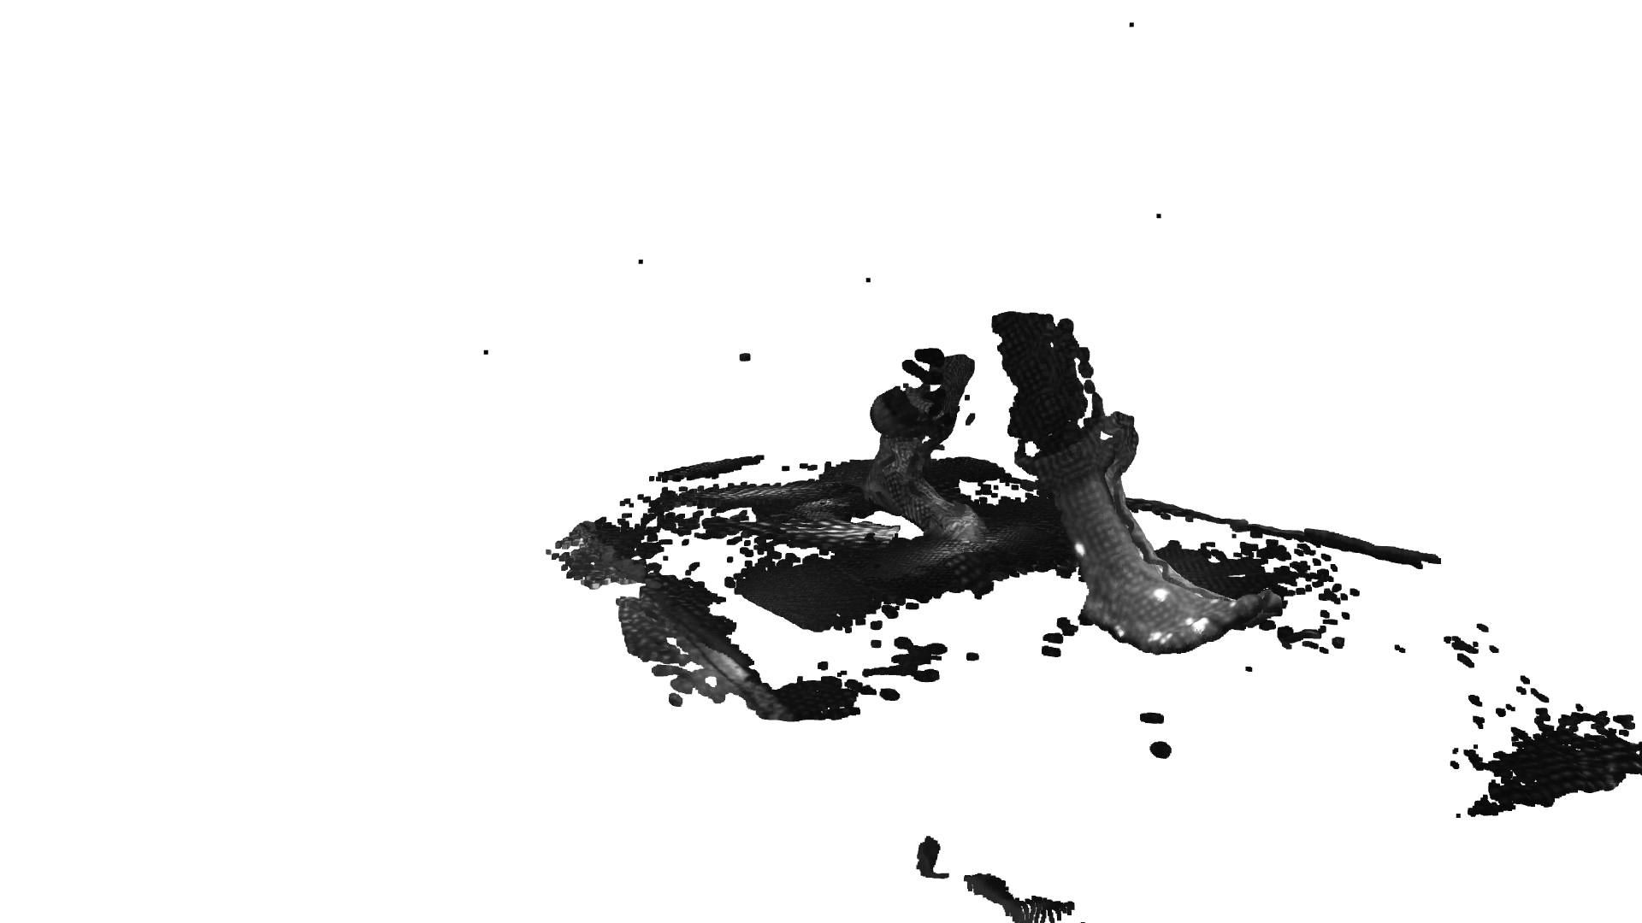
1
2
3
4
5
6
Notes:
Review order of slides

Slide 34
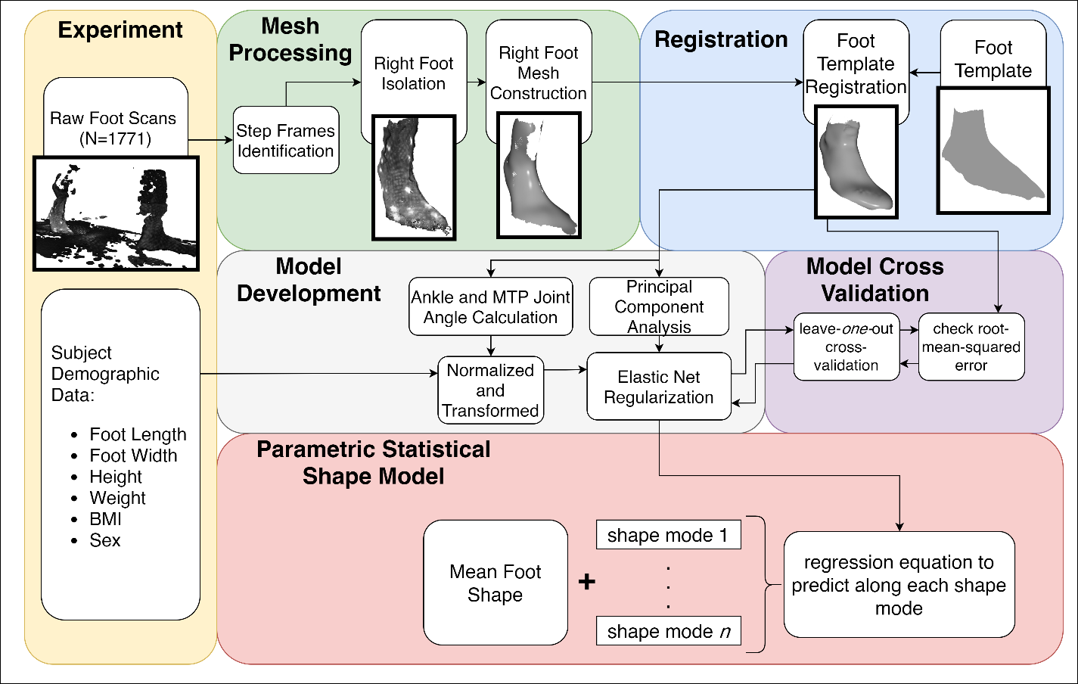
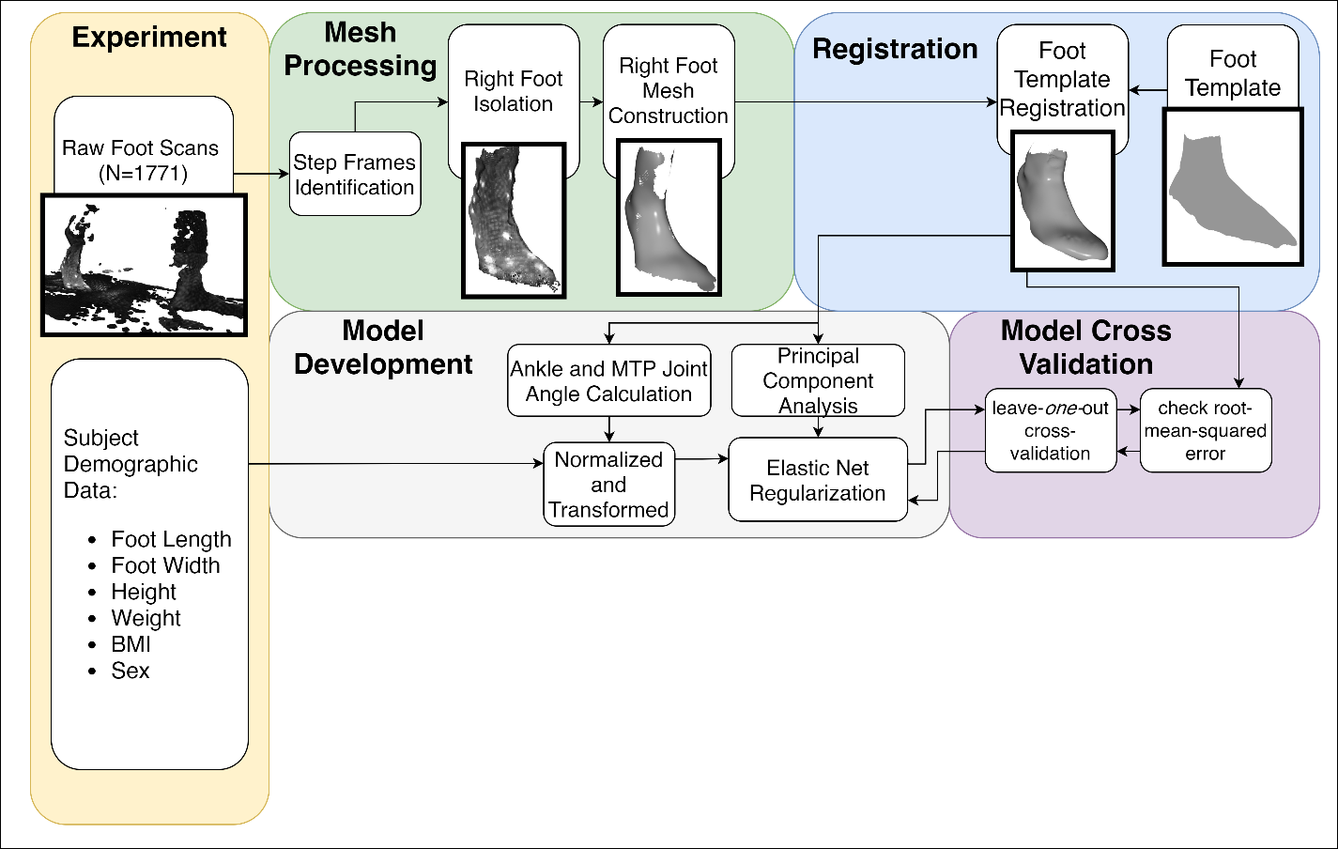
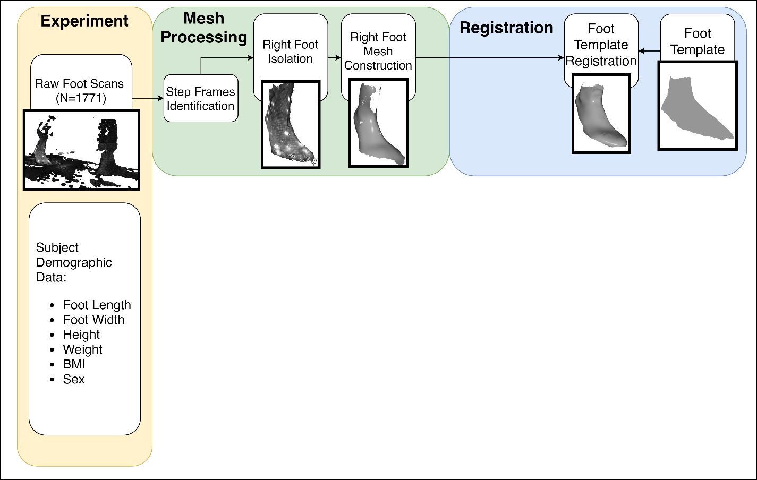
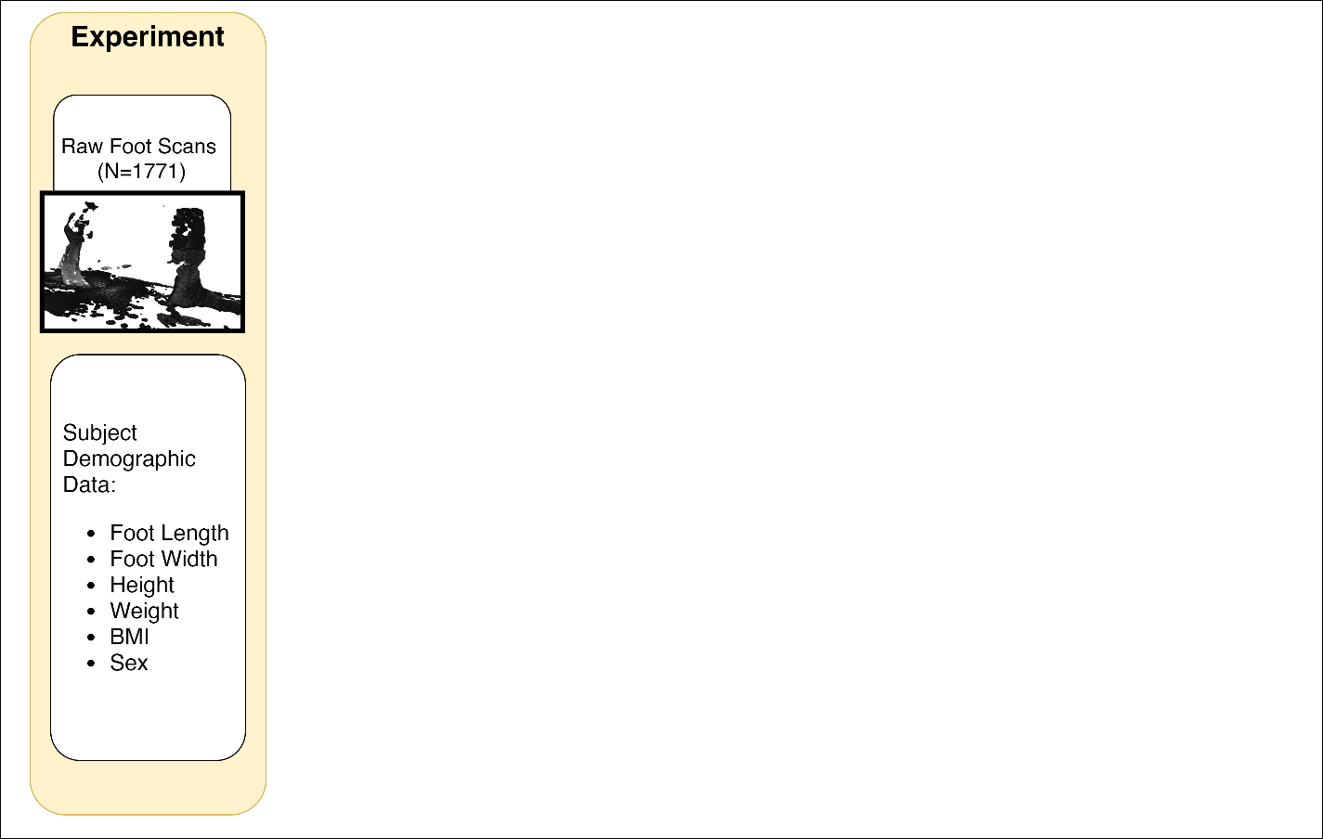
Shape Model Development
Foot template provided by Dr. Matthew Reed - University of Michigan Transportation Research Institute
Each shape mode is a principal component identifying the axes of highest variance

Slide 35
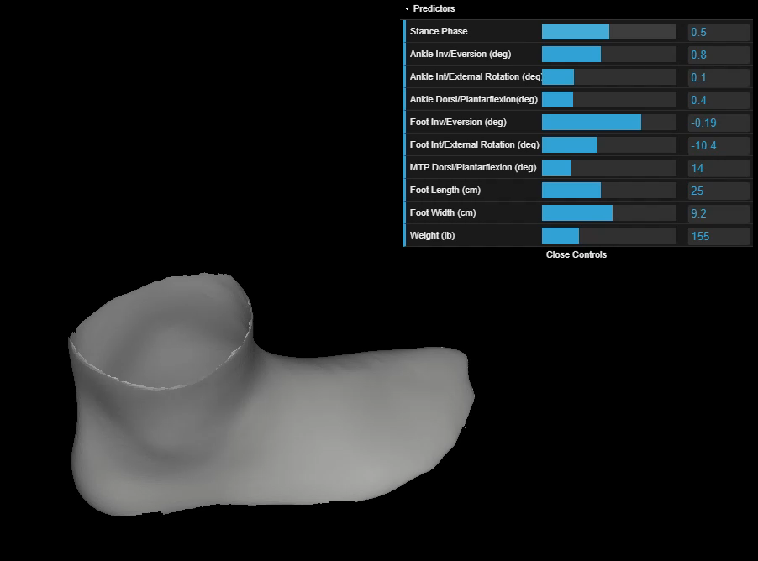
Predictive Foot Shape Model
Final model predicts 8 principal components (95% of total variance)
Inputs: kinematic variables, foot length, foot width, and weight
Sex not found to be a predictive variable
Accuracy: 5.2 mm ± 2.0 mm
Play with the model yourself at:
http://tiny.cc/dynafootModel
¹Boppana, A., & Anderson, A. P. (2020). Dynamic foot morphology explained through 4D scanning and shape modeling. ArXiv:2007.11077.
Notes:
Highly cross-correlated predictors removed
Arch-length
Body mass index
height
Mention that these are distributions, show how similar they are

Slide 36
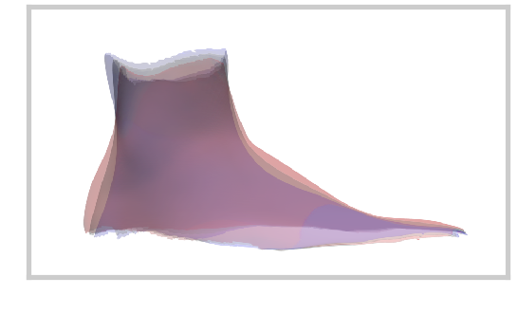
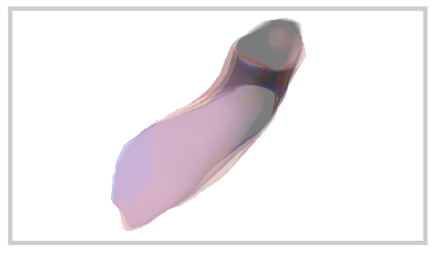
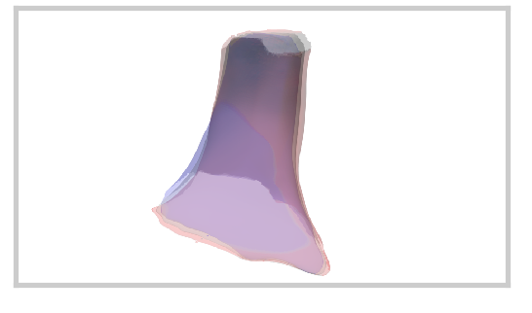
Dynamic Foot Shape Changes
After heel-off (as the MTP joint is dorsiflexing)
Midfoot girth decreased
Heel goes from rounded shape to sharp shape
Just prior to toe-off (ankle eversion and external rotation)
Midfoot, ankle, and MTP joint girth increased
medial malleolus girth decreased
A
B
C
Changes in midfoot girth (A,B), ankle girth (B,C),and malleolus girth (C) during gait
¹Boppana, A., & Anderson, A. P. (2020). Dynamic foot morphology explained through 4D scanning and shape modeling. ArXiv:2007.11077.

Slide 37
Dynamic Foot Shape Changes
After heel-off (as the MTP joint is dorsiflexing)
Midfoot girth decreased
Heel goes from rounded shape to sharp shape
Just prior to toe-off (ankle eversion and external rotation)
Midfoot, ankle, and MTP joint girth increased
medial malleolus girth decreased
Target to mitigate heel-lift
A
B
C
Changes in midfoot girth (A,B), ankle girth (B,C),and malleolus girth (C) during gait
¹Boppana, A., & Anderson, A. P. (2020). Dynamic foot morphology explained through 4D scanning and shape modeling. ArXiv:2007.11077.

Slide 38
Instep Height and Girth Analysis
Footwear design requirements to accommodate dynamic midfoot shape changes needs linear measurement of change
Volumental AB has characterized instep height and instep girth, representing midfoot shape, across 1.2 million footwear consumers¹
¹Jurca, A., Žabkar, J., & Džeroski, S. (2019). Analysis of 1.2 million foot scans from North America, Europe and Asia. Scientific Reports, 9(1), 1–10.

Slide 39
Dynamic Changes in Instep Height
Foot’s medial longitudinal arch (MLA) is known to be dynamic through stance phase¹
Collaboration with Volumental will characterize dynamic foot midfoot shape changes within the scope of population midfoot measurements
Objective: Investigate whether dynamic changes in instep height due to MLA are correlated to static foot measurements
¹Ker R.F., Bennett M.B., Bibby S.R., Kester R.C., Alexander R.M. (1987). The spring in the arch of the human foot. Nature.

Slide 40
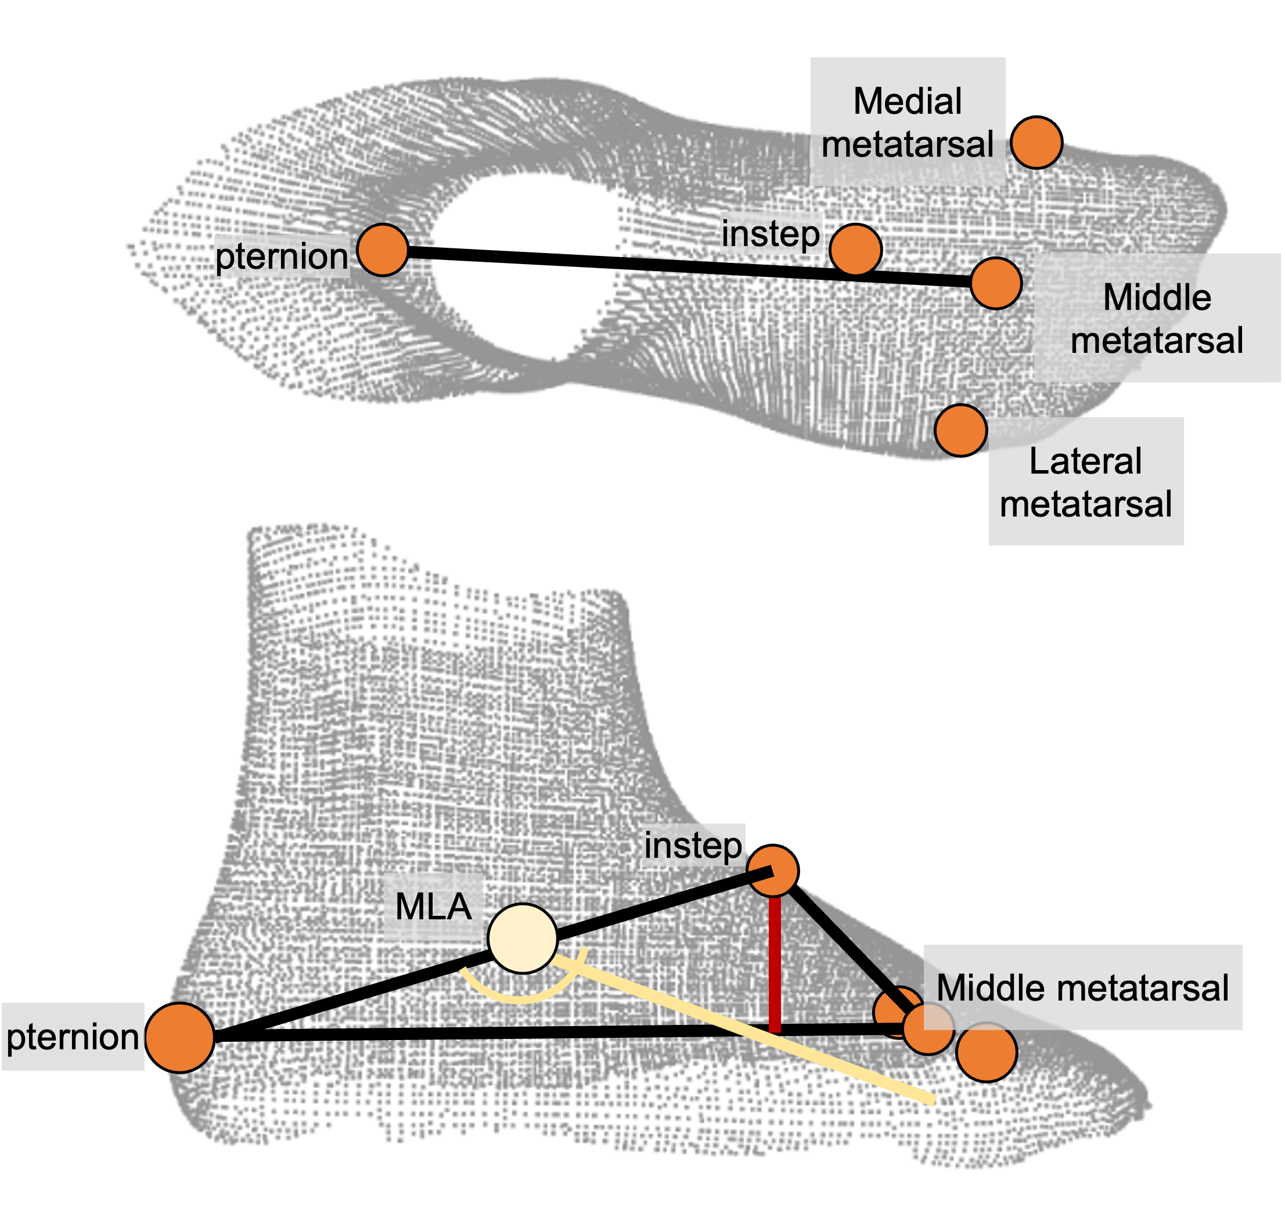
Instep Height Measurement
New methodology to measure instep height without plantar foot surface

Slide 41
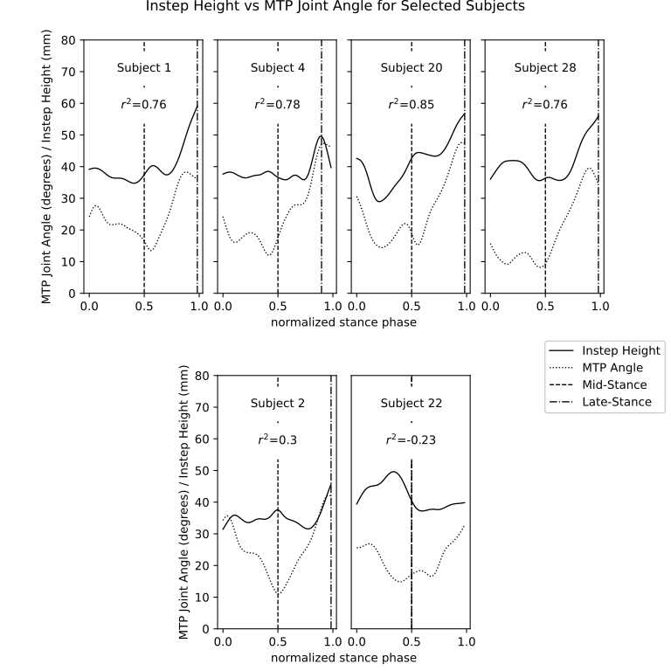

Slide 42
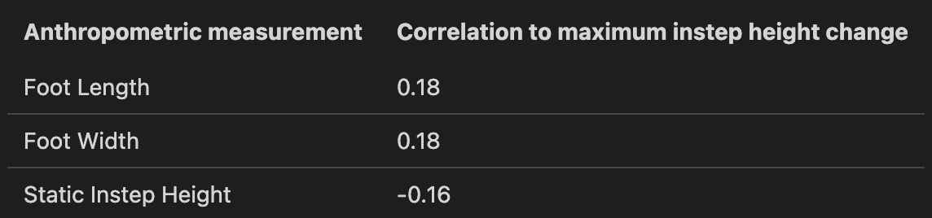
Results
Low correlations between dynamic instep height and foot anthropometrics

Slide 43
Summary
Conclusions:
Statistical shape model created to predict dynamic foot shape during gait from subject anthropometry and kinematics
Model shows dynamic changes at instep and heel that can be targeted in design to reduce heel-lift
Low correlations between the dynamic instep height and subject anthropometrics suggest that adjustability is needed to accommodate static and dynamic instep height in footwear design

Slide 44
Specific Aim 3
Define a design process integrating dynamic foot morphology data for a novel spacesuit boot

Slide 45
Background
Previous planetary spacesuit boot designs based on pressurized modified hiking boots and have not been able to mitigate heel-lift and boot comfort issues
Design process based on iteration and subjective feedback
No clear process for integrating all available data, including dynamic foot morphology data, into the design process

Slide 46
Objectives
Literature review of existing foot shape and mobility knowledge
Development of a design framework to design a more compatible spacesuit boot
Design and construction of a spacesuit boot prototype leveraging the design framework

Slide 47

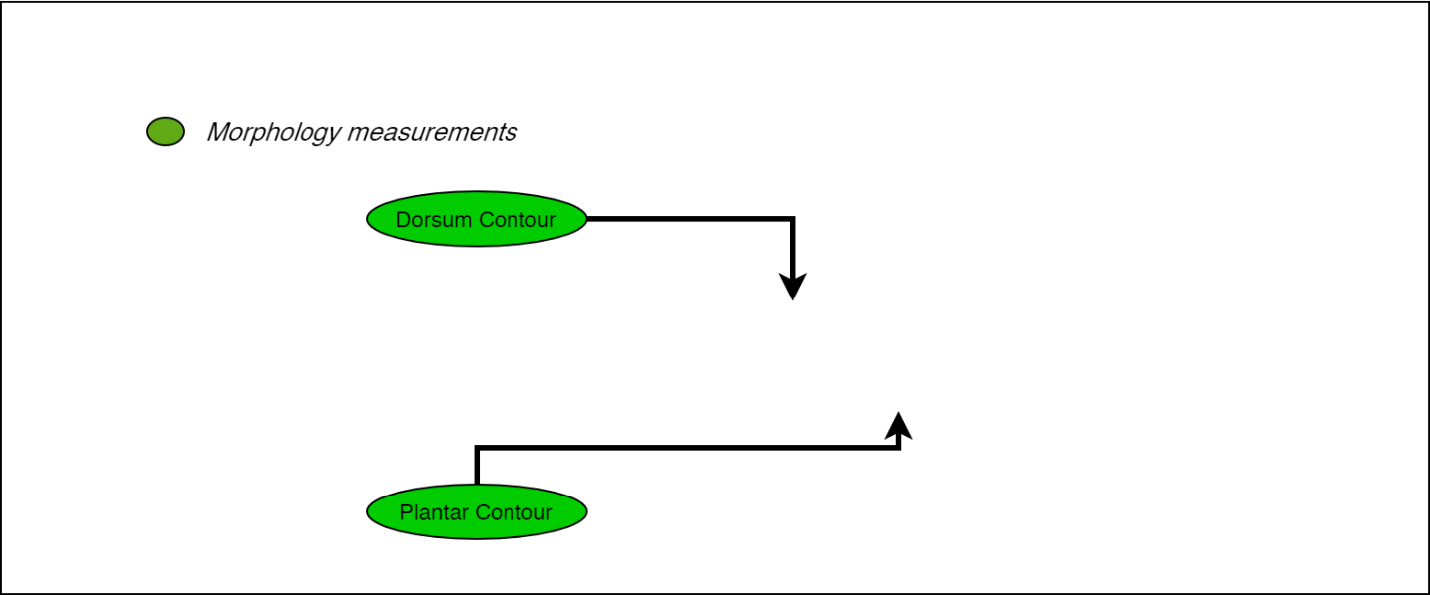
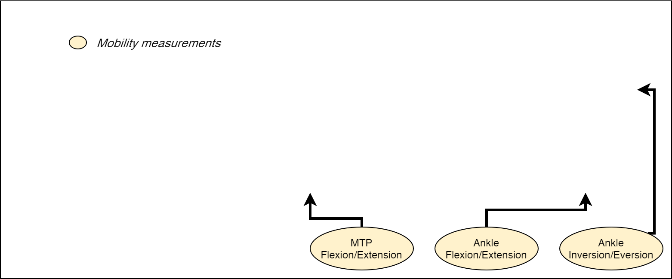
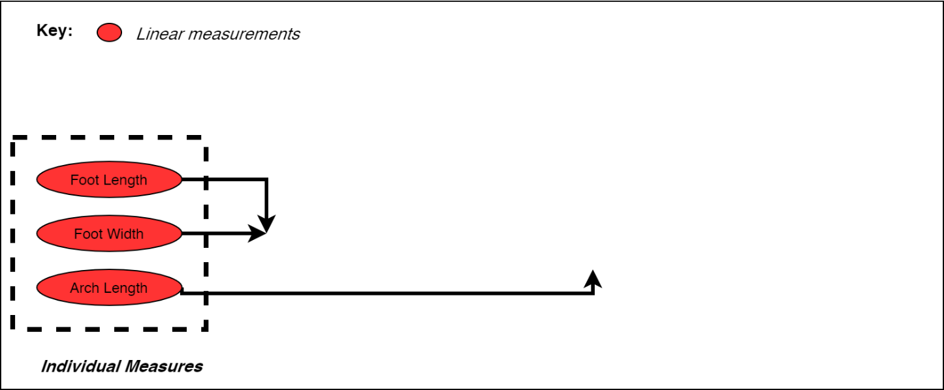
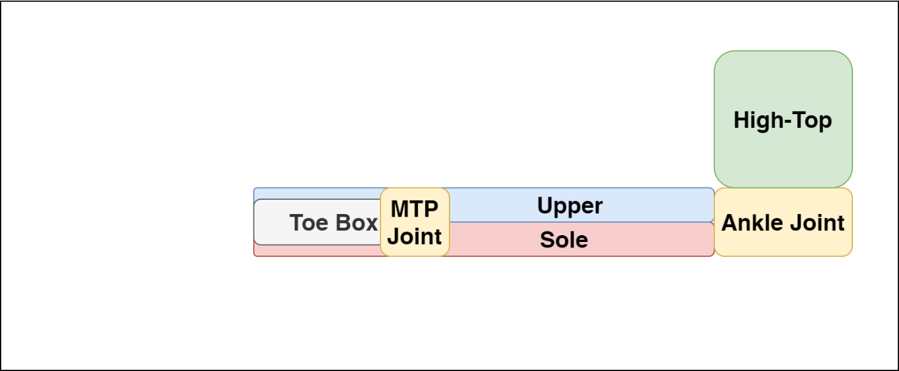
Boot Design Framework
Individual linear measurements to be used to define sizing elements
Nominal values for joint mobility to be integrated into boot design
Morphology measurements to define shapes
¹Boppana, A., & Anderson, A. P. (2020). A Biomechanical Design Framework to Improve Spacesuit Boot Fit. 50th International Conference on Environmental Systems.
Notes:
Animate the different bullet points to diagram
Make sure to go over the different boot parts, break it down for the audience

Slide 48
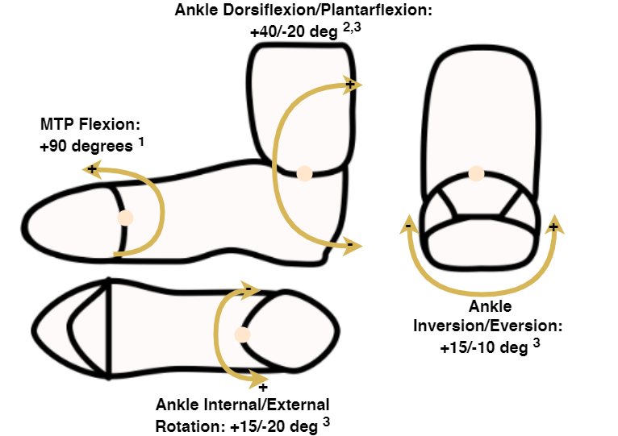
Nominal Foot Mobility Values
Nominal values taken from mobility while walking on uneven² and sloped surfaces³
Design should allow for joints to stabilize and provide power
Ankle joint dorsi/plantarflexion consistent with NASA requirements⁴
Ideal foot mobility, with references cited below
¹Mann, R. A., & Hagy, J. L. (1979). The function of the toes in walking and running. Clinical Orthopaedics & Related Research, July(142), 24–29.
²Voloshina, A. S., Kuo, A. D., Daley, M. A., & Ferris, D. P. (2013). Biomechanics and energetics of walking on uneven terrain. Journal of Experimental Biology, 216(21), 3963–3970.
³Wannop, J. W., Worobets, J. T., Ruiz, R., & Stefanyshyn, D. J. (2014). Footwear traction and three-dimensional kinematics of level, downhill, uphill and cross-slope walking. Gait and Posture, 40(1), 118–122.
⁴NASA. (2019). Small Business Innovation Research (SBIR) & Small Business Technology Transfer (STTR) Fiscal Year 2019 General Solicitation.
Notes:
Verbally say what the requirements lack in NASA (MTp joint, other ankle mobility)

Slide 49
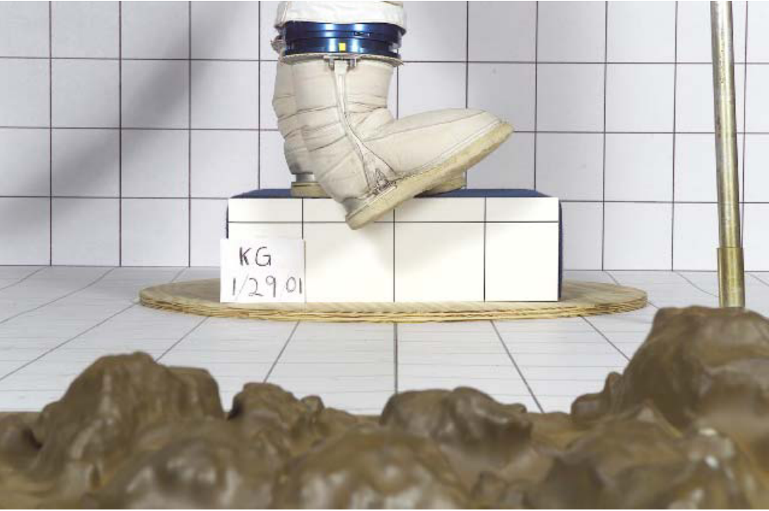
Ankle Mobility
Allow for mobility while reducing injury risk
Unrestricted ankle dorsi/plantar flexion for efficient push-off
Stabilized inversion/eversion and internal/external rotation to prevent injury from external forces¹
Convoluted ankle joint can provide dorsi/plantarflexion and inversion/eversion
Internal/external rotation provided by rotational bearing
Rotational Bearing
Convoluted Ankle Joint
Example of convoluted ankle joint with ankle bearing on a modified EMU boot²
¹Böhm, H., & Hösl, M. (2010). Effect of boot shaft stiffness on stability joint energy and muscular co-contraction during walking on uneven surface. Journal of Biomechanics, 43(13), 2467–2472.
²Ross, A. J., Kosmo, J. J., Moiseyev, N., Stoklitsky, A., Barry, D., & Hodgson, E. (2002). Comparative space suit boot test. SAE Technical Papers.

Slide 50
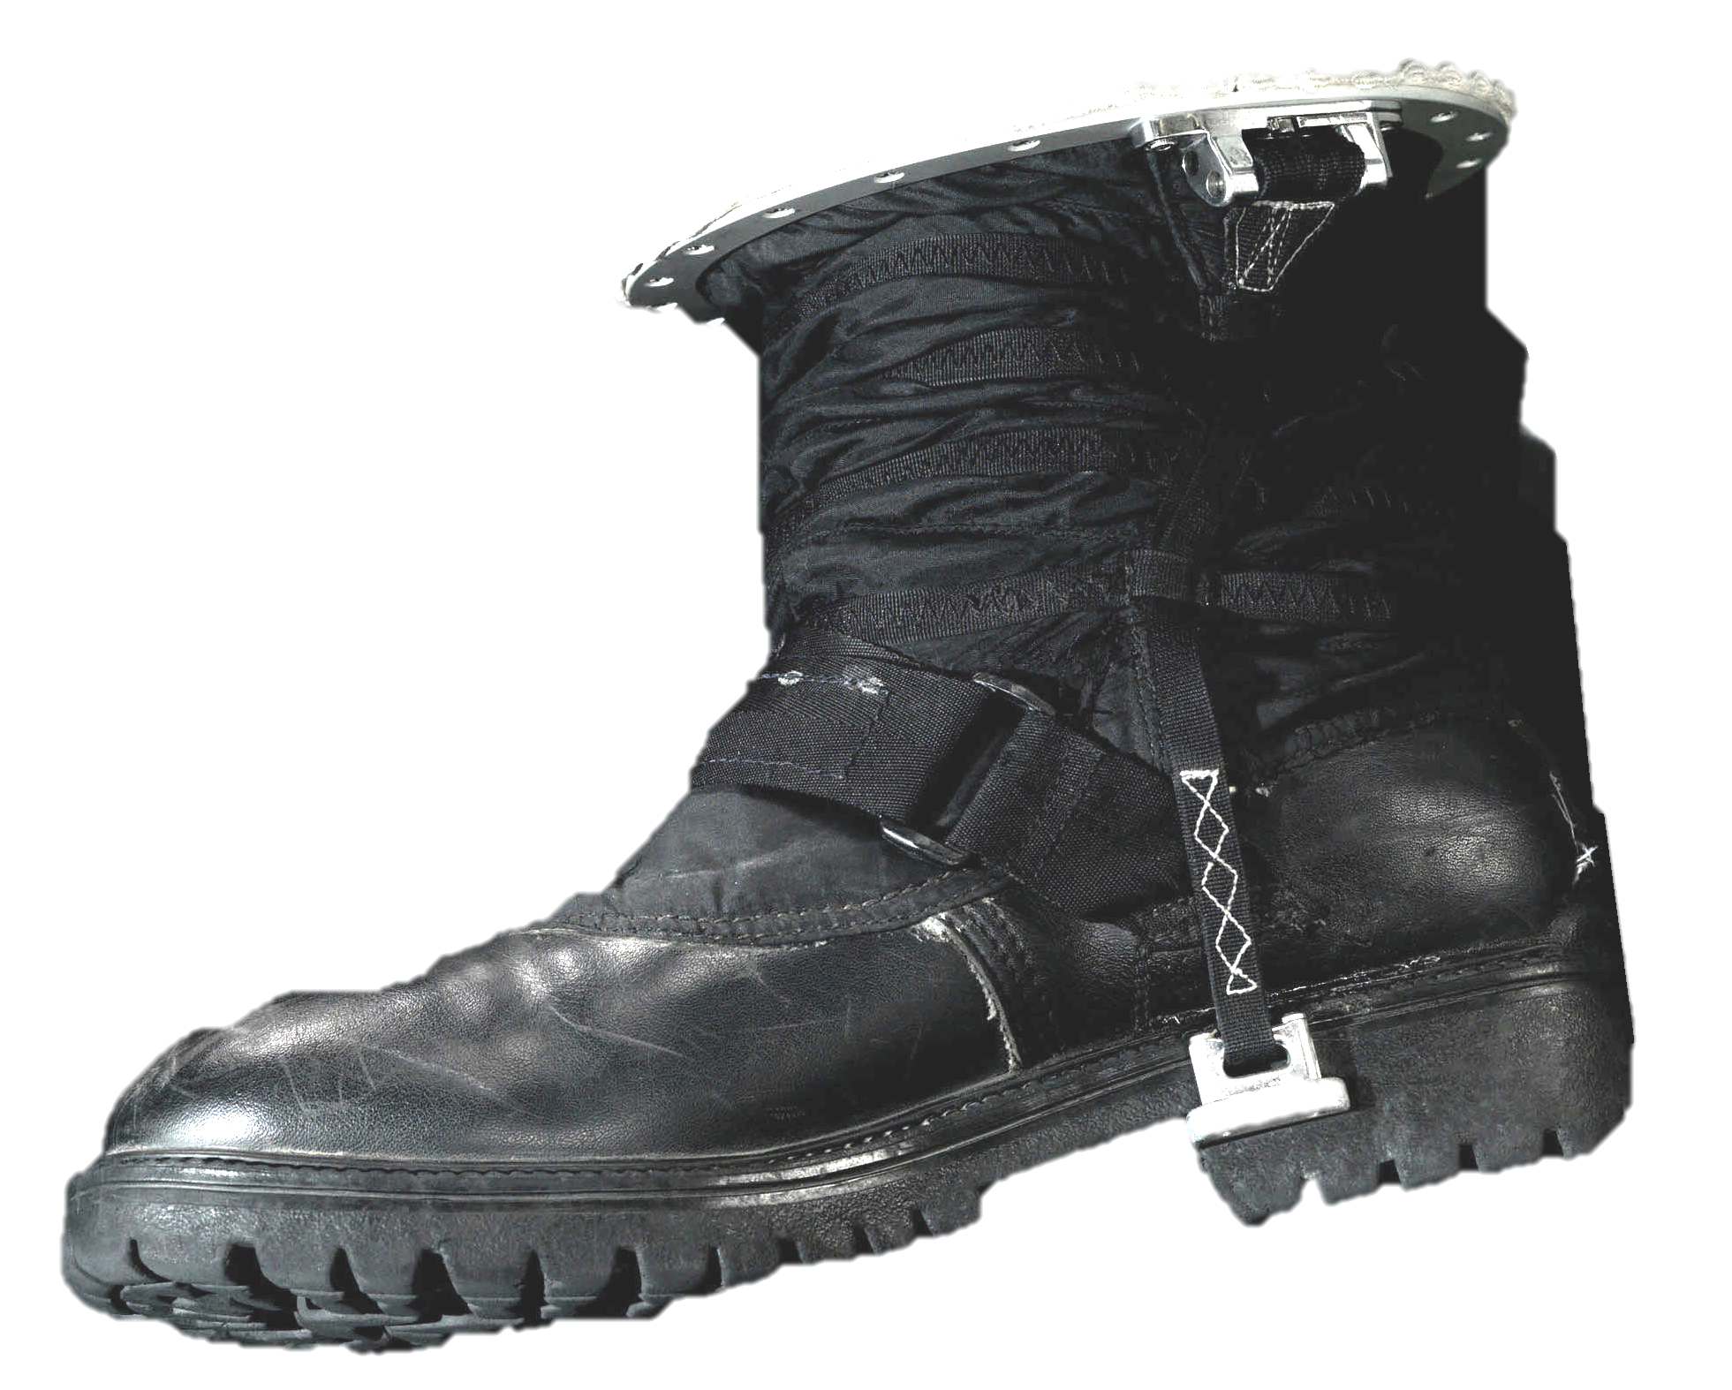
MTP Joint Mobility
Terrestrial footwear allows for bending at MTP joint
Current planetary spacesuit prototype boots do not feature MTP joint due to difficulty integrating into pressure bladder
Prototype will use sole curvature to allow for push-off without flexion at MTP joint¹
Planetary spacesuit boot prototype with curve sole allowing for push-off²
¹Nigg, B. M., Cigoja, S., & Nigg, S. R. (2020). Teeter-totter effect: A new mechanism to understand shoe-related improvements in long-distance running. British Journal of Sports Medicine, 0(0), 1–2.
²NASA. (2019). Small Business Innovation Research (SBIR) & Small Business Technology Transfer (STTR) Fiscal Year 2019 General Solicitation.

Slide 51
Spacesuit Boot Design
Additional rolling convolute along upper to secure instep
BOA lacing system for donning/doffing and dynamic tightening
Rotating the BOA dial allows for the lacing to tighten the upper and capture the foot
Plantarflexion during heel-off increases the length of the lace path, thereby pulling the lacing tighter
Notes:
Rolling convolute joint with 3 sections for ankle mobility
Additional rolling convolute runs along foot, and allows the upper to tighten and capture the foot. This is controlled through routing of the lacing system
Integrating a single termination point BOA lacing system which is placed above the ankle joint. We found that placing the dial in this location, allows for the lacing to be pulled during ankle plantarflexion, which occurs during heel-off. The lacing is run through a tube to prevent compression of the ankle joint while further tightening the upper.
A traditional heel counter will help further secure the heel against the shape changes associated with unloading of the heel
We will test our design through human subject testing assessing comfort through workload and ergonomics surveys, mobility through range of motion assessments, and heel-lift by placing a contact sensor in the heel
We aim to show that our boot is more comfortable, similarly mobile, and reduces the instances of heel lift, thereby showing that dynamic body shape models may improve spacesuit fit and reduce the risk of injury
Allie’s comments:
Transition from slide 3, to address instep + heel changes, we’re starting from a standard EVA boot (which just has a rolling convolute ankle joint), then add instep lacing, then add heel counter
Color code for instep and color code for heel counter in
Animation of BOA lace dynamic tightening
Focus on lacing and dynamic tightening of the upper rather than directly saying it’s a rolling convolute
Heel counter: rather than saying its just a commercial heel counter, we want to say we are iterating on designs that accommodate that shape change

Slide 52
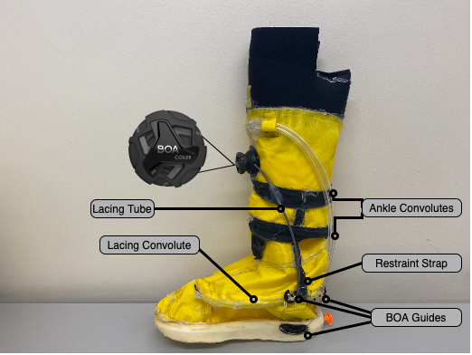
Novel Spaceboot Prototype

Slide 53
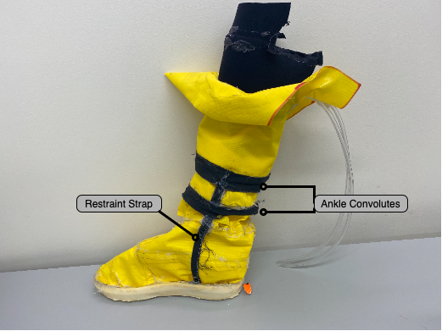
Classic Spaceboot prototype
Classic spaceboot prototype was constructed for later comparison
Representative of current spaceboots

Slide 54
Summary
Conclusions:
Planetary spacesuit boot design can incorporate existing knowledge on foot mobility, population measures, and dynamic foot morphology
Novel spaceboot design with lacing and heel counter to accommodate foot shape changes and reduce heel lift
Design translated into functioning pressurized prototype

Slide 55
Specific Aim 4
Evaluate novel planetary spacesuit boot design for fit, comfort, and mobility

Slide 56
Background
Prototype boot needs to be validated to test effects of using dynamic foot morphology as a design input on mobility, comfort, and ability to reduce heel-lift
Gold standard for planetary EVA is an unpressurized hiking boot
Current technology can be represented as a modified, pressurized, hiking boot with a convoluted ankle joint

Slide 57
Objectives
Construct interface between test boots and test environments
Evaluate the mobility of the novel design against a standard hiking boot and pressurized hiking boot
Evaluate the comfort of the novel design against a standard hiking boot and pressurized hiking boot
Evaluate the novel design for its ability to reduce instances of heel lift against a standard hiking boot and pressurized hiking boot

Slide 58
Testing Hypotheses
The novel boot design will provide:
equivalent comfort compared to the laced workboot
improved comfort compared to the classic spaceboot and unlaced working boot
The novel boot design will induce:
same number of instances of heel lift as the hiking boot
fewer instances of heel lift compared to the pressurized hiking boot

Slide 59
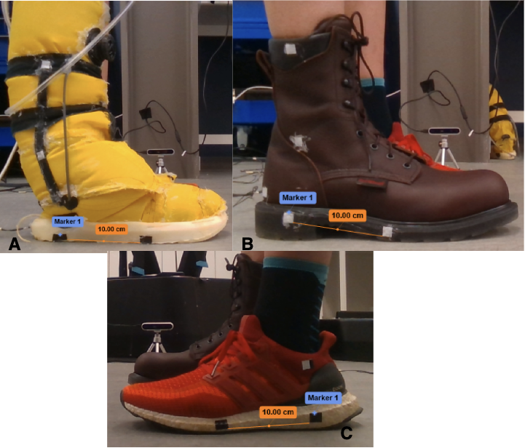
Conditions
Novel Spacesuit Boot
Laced Workboot
Classic Spacesuit Boot
Unlaced Workboot

Slide 60
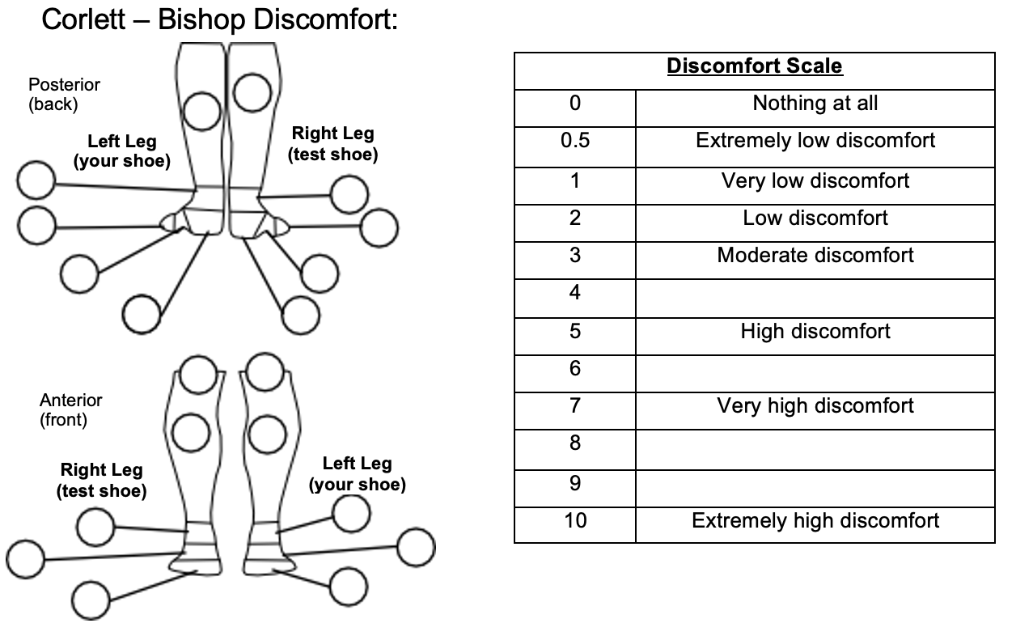
Survey Meausrements
Surveys:
Heel Performance
0: like flip-flop, 10: like tennis shoe
Corlett-Bishop Discomfort for below knee
Rating of Perceived Exertion

Slide 61


Quantitative Measurements
Quantitative Measures:
Force Sensitive Resistor (FSRs):
Mounted underneath heel in all boots
0V: Full contact, 3.3V: No contact
Heel-raise height measured with cameras
FSRs embedded in soles
FSR Calibration Curves

Slide 62
Test Procedures
Subject wears test shoe on right foot, control sneaker on left shoe
Test shoe is pressurized if spaceboot
Subject performs 5 heel raises
As slow as possible, while synchronizing left and right feet
Subject performs short walk
Subject fills out survey for each shoe

Slide 63

Data Analysis

Slide 64

Results

Slide 65

Results

Slide 66

Results

Slide 67

Results

Slide 68

Results

Slide 69

Results

Slide 70

Results

Slide 71
Summary
When performing a heel-raise, both the novel spaceboot and laced workboot appear to maintain contact with the heel at heel-off.
However, the novel spaceboot appears to maintain some contact throughout the heel-raise, and allows subjects to achieve their highest performance heel-raise.
Survey measurements report the novel spacesuit boot having a lower heel performance than the laced spaceboot, but a higher heel performance compared to the unlaced workboot and classic spacesuit boot.
It is clear that the novel spacesuit boot is an improvement over the classic spacesuit boot and unlaced workboot, but it is unclear whether it is equivalent, better, or worse than the laced workboot as various metrics have shown all these possibilities.

Slide 72
Research Summary and Execution Plan

Slide 73
Contributions
Showed drawbacks of using IMUs to detect instances of heel-lift and identified alternative methods to explore in future work
Gap: Few efforts to quantify fit discrepancies
A novel software library to use multiple commercial depth cameras as a cost-effective 4D scanner, capable of collecting body shape changes at 90 frames-per-second
Gap: Limited knowledge on dynamic body shape changes due to motion
A parametric statistical shape model that predicts dynamic foot shape during stance phase as a function of anthropometry and kinematics
Gap: Limited knowledge on dynamic body shape changes due to motion
A design framework integrating dynamic foot shape knowledge with known foot mobility to design a novel spacesuit boot to improve fit and comfort
Gap: No existing framework for incorporating dynamic body-shape models into the spacesuit design and fit process

Slide 74
Contributions
Quantification of dynamic changes in instep height and instep girth as they relate to their distribution in the global population
Gap: Limited knowledge on dynamic body shape changes due to motion
A novel spacesuit boot prototype developed from the framework that aims for better fit and comfort, and specifically a reduction in heel-lift
Gap: No existing framework for incorporating dynamic body-shape models into the spacesuit design and fit process
Evaluation of the novel spacesuit boot for comfort and mobility against current planetary spacesuit boot technology and a gold-standard hiking boot
Gap: No studies to quantify the effect of using body-shape models over linear measurements on fit and mobility

Slide 75
Hypothesis
Integrating dynamic body shape changes into the spacesuit boot design process will mitigate factors that lead to injury and improve compatibility between the operator and the spacesuit.

Slide 76
Hypothesis
Integrating dynamic body shape changes into the spacesuit boot design process will mitigate factors that lead to injury and improve compatibility between the operator and the spacesuit.
SA2 models dynamic foot shape changes

Slide 77
Hypothesis
Integrating dynamic body shape changes into the spacesuit boot design process will mitigate factors that lead to injury and improve compatibility between the operator and the spacesuit.
SA3 incorporates dynamic foot morphology changes, along with existing knowledge of footwear design and foot mobility into a design framework used to develop a novel spacesuit boot design

Slide 78
Hypothesis
Integrating dynamic body shape changes into the spacesuit boot design process will mitigate factors that lead to injury and improve compatibility between the operator and the spacesuit.
SA1 found that quantifying heel-lift, a symptom of poor-fit and a potential precursor to injury, is not achievable through current IMU technology and may require a heel-contact sensor to directly measure heel-lift
SA4 will evaluate the novel boot design in SA3 for its mobility, comfort, and occurrence of heel-lift

Slide 79
Peer-Reviewed Publications
TYPE | TITLE | JOURNAL | Date | Specific Aim
Technical Note | Detecting Heel-Lift in Spacesuit Gait | Aerospace Medicine and Human Performance | Jan 2022 (under review) | SA1
Journal Paper | DynaMo: Dynamic Body Shape and Motion Capture with Intel RealSense Cameras | Journal of Open Source Software | Sept 2019 | SA2
Journal Paper | Dynamic foot morphology explained through 4D scanning and shape modeling | Journal of Biomechanics | June 2021 | SA2
Conference Paper | A Biomechanical Design Framework to Improve Spacesuit Boot Fit | 50th International Conference on Environmental Systems | July 2020 | SA3
Journal Paper | Static and Dynamic Distribution of Instep Height | Footwear Science | Jan 2022 (under review) | SA2
Journal Paper | Design and Evaluation of a Novel Planetary Spacesuit Boot | Nature Microgravity | May 2022 | SA3/SA4
Key:
Planned
In Progress
Completed
Notes:
Use blue-yellow-green scheme to show progress

Slide 80
Conference Presentations
TYPE | TITLE | CONFERENCE | DATE | Specific Aim
Talk | Using dynamic foot morphology data to design spacesuit footwear (Martyn Shorten Award For Innovation) | Footwear Biomechanics Symposium | July 2019 | SA2
Talk | Development of a Dynamic 3D Scanning System with Multiple Intel RealSense Depth Cameras | International Society of Biomechanics Congress | Aug 2019 | SA2
Poster | Quantifying the Heel Lift during Spacesuit Gait | NASA HRP IWS | Jan 2020 | SA1
TBD | Dynamic Body-Shape Models to Reduce Risk Of EVA Spacesuit Injury | NASA HRP IWS | Feb 2021 | Overall
Poster | Using Dynamic Foot Shape Models to Design a Better Spacesuit Boot | International Conference on Environmental Systems | July 2021 | SA3
TBD | Novel Spacesuit Boot Design Developed from Dynamic Foot Shape Modeling | Footwear Biomechanics Symposium | July 2021 | SA3
TBD | Spacesuit Boot with Improved Comfort and Mobility Developed from Dynamic Shape Modeling | NASA HRP IWS | Jan 2022 | SA4
Key:
Planned
Completed
Notes:
Retitle to confrerence presentations
Add ICES conference poster

Slide 81
Planetary Exploration Benefits
2020 NASA Technology Taxonomy TX06.2.1 defines the spacesuit as a complex system of soft-goods and mobility elements to optimize performance while pressurized without inhibiting unpressurized operations
Planetary exploration requires safe and comfortable spacesuits to enable successful EVA
Boot design framework presented in this thesis will allow for the planetary exploration boots which reduce instances of heel-lift over current spacesuit boots
Thesis can be expanded in future work for other spacesuit components with high injury risk, such as gloves and the hard upper torso

Slide 82
Acknowledgements
CU Boulder Bioastronautics Students and Faculty
CU Boulder Biomechanics Group
Rodger Kram, Wouter Hoogkamer, Ryan Alcantara, Alena Grabowski
MIT Human Systems Lab
Leia Stirling, Richard Fineman, Tim McGrath
Steven Priddy – CU Boulder Aerospace Engineering
Shane McFarland – NASA JSC Advanced Suit Lab
Shane Jacobs – David Clark
BOA Technology
Brett Vladika, Dan Feeney
Matthew Reed – University of Michigan Transportation Research Institute
University of Oregon Portland Sports Product Design Program
Alex Xu, Susan Sokolowski
Ales Jurca – Volumental AB
Funding
NSF Graduate Research Fellowship (Grant #: DGE 1650115)
Smead Scholars

Slide 83



Slide 84
Backup Slides

Slide 85
Spacesuit Contact Injuries
Bruises, contusions
Most common reported injury in EMU
Hands, feet, elbow, knee, trunk
Also reported in Apollo missions at hands
Repeated and high pressure contact between suit and wearer

Slide 86
Spacesuit Musculoskeletal Injuries
Muscle tears, strains, inflammation
Hands and elbows in EMU
High exertion of bending joints
Shoulder in EMU
Excess internal rotation to perform certain reaches
Some cases of surgery

Slide 87
2020 NASA Technology Taxonomy
TX06.2: Extravehicular Activity Systems
TX06: Human Health, Life Support, and Habitation Systems
TX06.2.1: Pressure Garment
Complex system of soft-goods and mobility elements to optimize performance while pressurized without inhibiting unpressurized operations

Slide 88
How is gait affected by the spacesuit?

Slide 89
Characteristics of Gait
Exertion measured qualitatively and quantitatively
Ratings of perceived exertion
Metabolic cost
Walking and running are very different metabolically and kinematically
PTS (Preferred transition speed)
Floquet Multiplier
Eigenvalues of periodic gait function transformed into linear function
>1: The person has tripped or fallen, closer to 1 more unstable

Slide 90

Planetary Ambulation Modeling
Froude number: $Fr=\frac{v^{2}}{gL}$
Ratio of centripetal/gravitational forces
Walk-run transition occurs at $Fr^{∗}=0.5$ for humans
Running in lower gravity not always energetically favorable
Skipping/Loping preferable on Moon
Studying walk-run transition provides insight into forces affecting translation

Slide 91

Suited Effects on Ambulation
Apollo Number: $Ap=\frac{Fr}{M}$
Incorporates effects of spacesuit self-support in walk-run transition
Validated against Apollo EVA Footage
Does not fully explain walk-skip transition

Slide 92

MK III 10 km Walkback Study
Can an astronaut feasibly perform a 10km suited walkback on the Moon?
6 male subjects fit to the MK III Suit
POGO Gravity offload system to replicate gravity level
¹Norcross JR., et al. Feasibility of Performing a Suited 10-km Ambulation on the Moon -Final Report of the EVA Walkback Test (EWT). (2009). NASA/TP-2009-214796
 | 3 speeds below PTS |  |  | 3 speeds above PTS |  |  | 10 km
1/6 g
3/8 g
1 g
Suited
Unsuited Baseline
Unsuited Weight-Matched
Notes:
Picture on right, experimental table highlighting (matrix)

Slide 93


MK III 10 km Walkback Study - Results
Bruising experienced by subjects during the 10km EWT¹
Gravity and suit increase Floquet multiplier
1/6g suited condition close to 1 → Decreased Stability
Metabolic cost increased with speed at all gravity levels
Cost of suit weight similar across 1/6g and 3/8g, cost of other factors larger in 3/8g
What are the other factors contributing to increased metabolic cost in suited gait?
¹Norcross JR., et al. Feasibility of Performing a Suited 10-km Ambulation on the Moon -Final Report of the EVA Walkback Test (EWT). (2009). NASA/TP-2009-214796

Slide 94
MK III Integrated Suit Test 1
Identify the individual contributions of weight, mass, pressure, and other factors to overall metabolic cost in MK III gait.
6 male subjects fit to the MK III Suit
POGO Gravity offload system to replicate gravity level
 | 3 speeds below PTS | 3 speeds above PTS | 3 speeds below PTS | 3 speeds above PTS
 | Unsuited |  | Suited
Varied Mass | 0, 25, 50, 75 lbs
Varied Weight | 0.17g, 0.27g, 0.32g |  | 0.12g, 0.17g, 0.22g, 0.27g, 0.32g
Varied Pressure |  |  | 1.0, 3.0, 4.3, 5.0, 6.5 psi
¹Norcross JR., et al. Metabolic Costs and Biomechanics of Level Ambulation in a Planetary Suit. (2010). NASA/TP-2010-216115
Notes:
Experimental matrix

Slide 95

MK III Integrated Suit Test 1 - Results
¹
Key Takeaway: Suit weight and pressure do not explain all of the increased metabolic cost in suited gait. Other suit/system factors could include inertial mass, stability, and biomechanics.
¹Norcross JR., et al. Metabolic Costs and Biomechanics of Level Ambulation in a Planetary Suit. (2010). NASA/TP-2010-216115

Slide 96


MK III Integrated Suit Test - Results
Knee ROM as function of pressure and speed¹
Ankle ROM as function of pressure and speed¹
Key Takeaway: At 4.3 psi, the knee and ankle have a complementary ROM. Joints work together along the kinematic chain to perform motion.
¹Norcross JR., et al. Metabolic Costs and Biomechanics of Level Ambulation in a Planetary Suit. (2010). NASA/TP-2010-216115
Notes:
Key takeaway text slightly bigger
Follow-on slide to introduce fit and its importance in indexing and joint motion

Slide 97


Spacesuit Fit and Indexing
Proper Fit
Improper Fit
Fit | Indexing
How the shape is related | How the body is aligned
Proper Indexing
Improper Indexing

Slide 98

MK III Relative Coordination Study
How do fit and indexing affect operational performance of the MK III suit?
3 male subjects fit to the MK III suit
Walking task with IMUs collecting kinematics
Unsuited
Suited (3x)
¹Fineman RA, et al. Objective Metrics Quantifying Fit and Performance in Spacesuit Assemblies(2019). Aero Med & Hum Perf.

Slide 99


MK III Relative Coordination Study-Results
Key Takeaway: Human-spacesuit coordination is not constant throughout time. Coordination varies dynamically.
¹Fineman RA, et al. Objective Metrics Quantifying Fit and Performance in Spacesuit Assemblies(2019). Aero Med & Hum Perf.
Notes:
Use this size for key takeaways
Big red circle showing in suit motion

Slide 100

Poor Fit Leads to Injury
DESIGN
COMPATIBILITY
Notes:
Poor fit is related to how the shape of your body relates to the shape of the suit
Poor indexing is how the skeleton of your body releates to the skeleton of the suit

Slide 101

Human Spacesuit Interaction Studies
Notes:
Author year to annotate each study

Slide 102

Objective Suit Fit Metrics
Current fit methodologies attempt to fit the spacesuit to the user, rather than design the spacesuit around the user.
¹Fineman RA, et al. Objective Metrics Quantifying Fit and Performance in Spacesuit Assemblies(2019). Aero Med & Hum Perf.
Notes:
Highlight that the static fit and mobility assessment aren’t happened outside research studies, only the post-evaluation
Operational suit fit is all subjective measures, not objective
Make this another slide

Slide 103
Objective Suit Fit Metrics
RESEARCH ENVIRONMENT
OPERATIONAL ENVIRONMENT
Operational environments do not currently allow for the assessment of objective suit fit metrics.
¹Fineman RA, et al. Objective Metrics Quantifying Fit and Performance in Spacesuit Assemblies(2019). Aero Med & Hum Perf.
Notes:
Highlight that the static fit and mobility assessment aren’t happened outside research studies, only the post-evaluation
Operational suit fit is all subjective measures, not objective
Make this another slide

Slide 104

Double-Integration Drift

Slide 105

Experimental Design
N = 30 (15M/15F)
Stratified sampling to maximize diversity in height to aim for large range of foot length
KEY
Male
Female
Notes:
Stratified sampling
Histogram/scatter plot, look at ices ansur data graph, shows uniform distribution

Slide 106

Experimental Design
KEY
Male
Female

Slide 107


Experimental Design

Slide 108


Example Foot Scan
Taken at ~0.1s after heel-off
Notes:
Cut off upper portion of foot

Slide 109



Dynamic Foot Template Registration
Template used from previously developed static foot shape model (Matt Reed, UMTRI)
Any holes can be filled from data in previous frames
Registration allows for shape analysis within and between subjects
Vertex IDs and density are aligned between each frame
Vertex IDs and density are aligned across subjects
SCAN
TEMPLATE¹
¹Reed MP, et al. Statistical Analysis to Develop a Three-Dimensional Surface Model of a Midsize-Male Foot (2013). UMTRI-­‐2013-­‐19
REGISTERED FOOT MODEL
Notes:
Combine with previous slide
Relook at figure, highlight filled in holes

Slide 110


Foot Template Registration
Iterative Closest Point Alignment
Roughly aligns template to same coordinate frame as scan, with initial guess (based on initial camera calibration)
Template is only rigidly transformed (rotated, translated)
KEY
Scan
Template
Notes:
Mention affine transformation as potential improvement?

Slide 111

Foot Template Registration
Scan cropping
Generate KD-tree of template for fast closest point searching
For every point in the scan, find corresponding closest point in template
If point is not within 5mm, point removed
Removes shank
KEY
Scan
Template

Slide 112

Foot Template Registration
KEY
Scan
Template
Radial basis function fitting
GIAS2¹ package fits knots (adaptively selected points) on template to scan
Thin-plate spline RBF function
¹Zhang J, et al. Point-cloud registration using adaptive radial basis functions (2018). Comp. Methods in Biomech. and Biomed. Eng.

Slide 113

Iterative Registration
Registered scan from previous frame serves as template for next frame
Seed point between toe strike and heel-off
Modified cropping and registration:
Template cropped as well to prevent holes from being registered on template
Two-step registration
Cropped template to scan
Original template to

Slide 114



Iterative Registration

Slide 115

Foot Template Evaluation
mm error
Notes:
Avg = 1.0 pm 0.6mm

Slide 116


Slide 117


Slide 118


Slide 119


Slide 120


Slide 121


Slide 122

Boot Shaft Stiffness (Bohm and Hosl 2010)
Hard vs Soft boot shaft stiffness
15 M subjects walked on coarse gravel
Significant Differences (soft vs hard):
Ankle ROM: 18.1 deg vs 16.7 deg
Weight acceptance phase (160ms vs 150ms)
Eccentric energy of knee increased with hard shaft
Eccentric energy of ankle decreased with hard shaft
Increased energy absorption at knee joint may lead to early fatigue of knee muscles, as knee muscles are typically used for stabilization
Tradeoff between lateral stiffness and free natural motion of ankle joint preferable
Boot shaft stiffness of hard vs soft boot shafts, applied with a prosthetic tester¹
¹Böhm, H., & Hösl, M. (2010). Effect of boot shaft stiffness on stability joint energy and muscular co-contraction during walking on uneven surface. Journal of Biomechanics, 43(13), 2467–2472.

Slide 123

Instron Testing
Test heat-sealable seam in accordance with ASTM D5035
Independent Variables:
Seam width (0.5in, 1in)
Heated time: (5s-30s, 5s intervals)
Dependent Variables:
Force at first breakage
Pull at 300 mm/min until 90% force drop off

Slide 124
Subject Size Spacesuit Studies
Fineman et al 2018: 3 subjects, 4 conditions, knee ROM
Power = 0.68
Effect size = 0.76
Showed significant differences between suited conditions for 2/3 subjects
Ross et al 2002: 7 total subjects
Only 2 did all conditions

Slide 125

Ross et al 2002: EMU Boot

Slide 126

Ross et al 2002: Russian Boot

Slide 127

Ross et al 2002: DCC Boot

Slide 128

Corlett Bishop Scale

Slide 129

Rating of Perceived Exertion

Slide 130


Slide 131

Isolated Foot Capture

